Slide 1
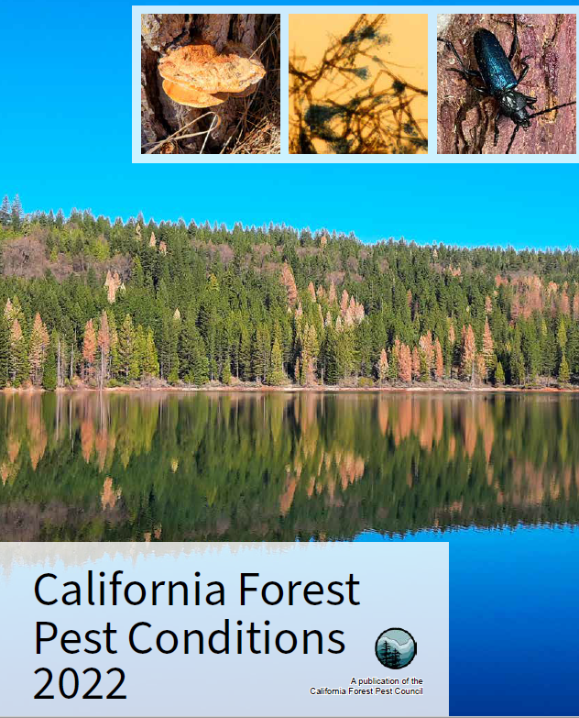
California Forest Pest Conditions Report 2022
Tom Smith
Forest Entomology and Pathology Program
CAL FIRE

Slide 2
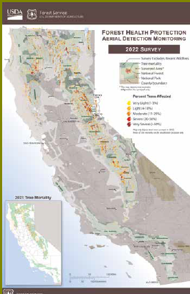
Aerial Detection Surveys
Surveyed 39.6 million acres
2.6 million acres with elevated tree mortality
Estimated 36.3 million dead trees
Much of the mortality was from fir engraver beetle or western pine bark beetle
Drought conditions also showed high levels of mortality, dieback or decline

Slide 3
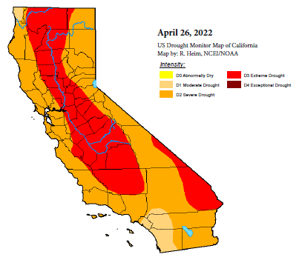
Drought and Weather
‘21/’22 precipitation was from 20 -75% of average depending on region of the state
January and February were the second driest on record
July through September temperatures were the hottest on record

Slide 4
Western Pine Bark Beetle
Pine bark beetle activity increased particularly in the central and northern Sierra Nevada and the counties around Clear Lake
Much of the activity was due to Western pine bark beetle
Also increases in Mountain and Jeffrey pine bark beetles

Slide 5
Fir Engraver Beetle
Fir engraver beetle mortality increased throughout higher elevations statewide
Trees tend to be more scattered than with the pine bark beetles
Trees sometimes survive with only the tops dying

Slide 6
Flat Headed Fir Borer
Extensive mortality occurred from flat headed fir borer all along the California coastal counties from Santa Cruz to the Oregon border
Douglas fir mortality was almost like being attacked by a bark beetle

Slide 7
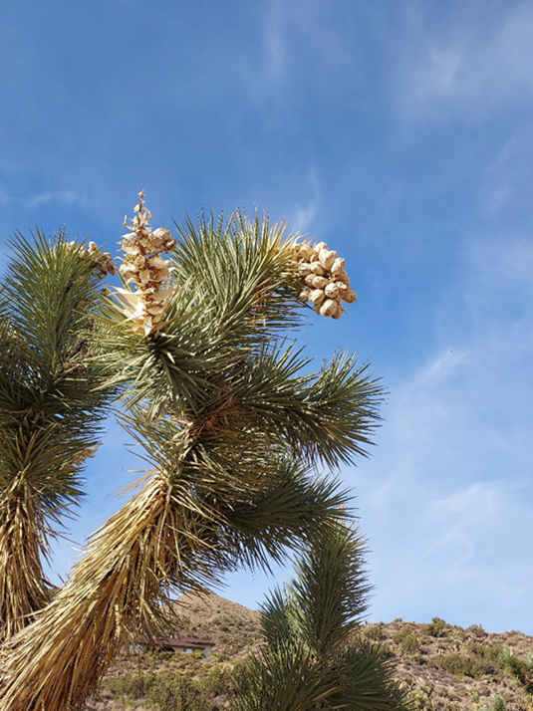
Yucca Weevil
Joshua trees in southern California were attacked by the yucca weevil
California native insect but this is a new host
The grubs bore down through the buds and stems causing dieback and mortality of trees

Slide 8
Invasive Shot Hole Borers
The two invasive shot hole borer complexes continue to spread throughout the southern California counties already impacted
No new counties have been infested through statewide trapping and tree surveys
Work continues on amplifier tree removals

Slide 9
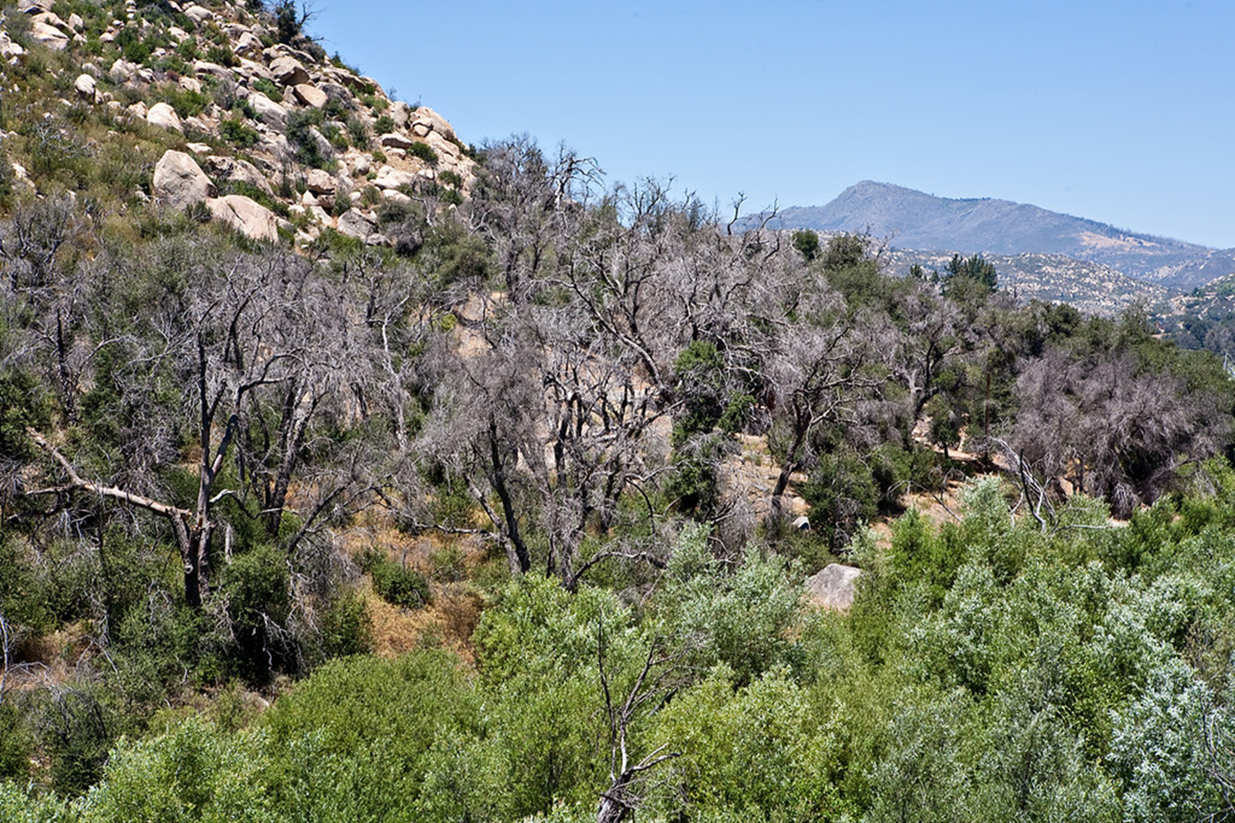
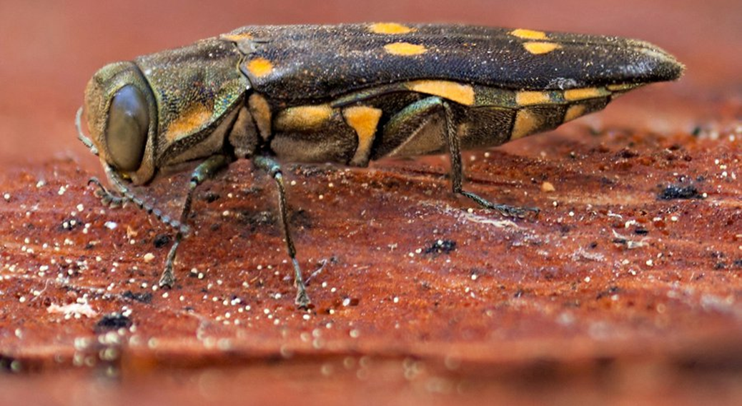
Goldspotted Oak Borer
New infestations in Los Angeles, Orange, San Bernardino and San Diego Counties
No new counties infested in 2022

Slide 10
Mediterranean Oak Borer
The complex has moved west of highway 101 in Sonoma County
Tagged valley oaks continue to decline
Permanent plots have been established in burned and unburned areas to determine the impacts of fire on MOB
Research continues on control options

Slide 11
Botryosphaeria Cankers
Many different genera of “Bot” fungi caused cankers in numerous host species
Many are thought to be endophytic or opportunistic on drought and/or heat stressed trees

Slide 12
Sooty Bark Disease
A new or newly recognized disease in California
Native to the Great Lakes Region
“Introduced” into the Puget Sound area of Washington State
Presently known from five maple trees in Elk Grove and El Dorado Hills

Slide 13
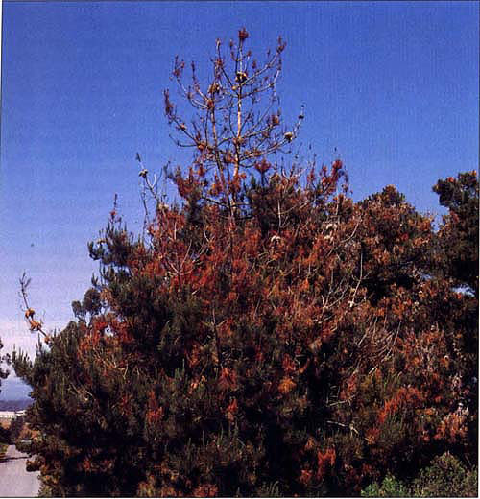
Pitch Canker Disease
Pitch canker disease has now been found up to 17 miles north of the Sonoma – Mendocino County line
The disease continues to move north in Mendocino County

Slide 14
Sudden Oak Death
Sudden oak death levels remained low due to dry conditions in 2022.
SOD did increase in parts of Redwood National Park and Mendocino and Sonoma Counties
SOD still has not been found in San Luis Obispo County even with dying tanoak stands
New satellite populations of the EU1 strain were found in Del Norte County

Slide 15
Heterobasidion Root Disease
Heterobasidion root disease remains one of the main native disease issues in California along with other root fungal diseases
The disease is common throughout true fir stands

Slide 16
White Pine Blister Rust
The fungus causing the introduced white pine blister rust was found on gooseberries (Ribes) in Los Angeles and San Bernardino Counties
Only the life stages found on Ribes have been found
No pine trees have been found infected that far south in California yet.
No infected pines are south of the southern Sierra Nevada

Slide 17
Abiotic Decline
Many of the impacted trees in the greater San Francisco Bay area that were severely impacted in the past appeared to be recovering in 2022
In particular, many eucalyptus and black acacia trees re-foliated during the year

Slide 18
Invasive Plants
CDFA continues work on biological control efforts of yellow star thistle and puncture vine
The rosette weevil is showing potential for control for yellow star thistle in the lab and populations are being raised for release
Biocontrol efforts of Cape Ivy are also ongoing

Slide 19
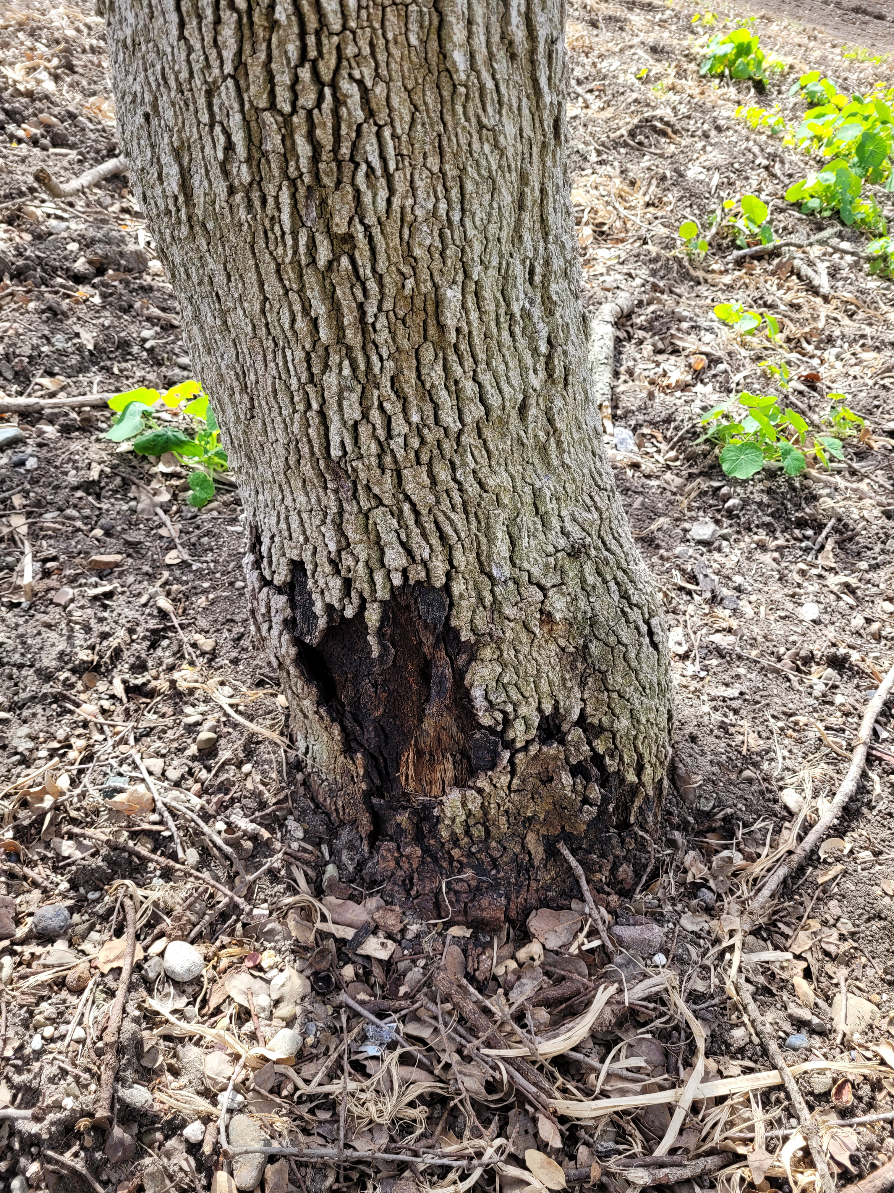
“Acute Oak Decline”
California’s newest pest issue
Found on blue oaks in Hollister, San Benito County
Other potential sites in Los Angeles and El Dorado Counties
Causal agent – Rahnella victoriana – a bacterium
Known to help cause acute oak decline in Britain and eucalyptus mortality in Iran

Slide 20
Questions?

