Slide 1
California Forest Pest Conditions Report 2024
Tom Smith
Entomology and Pathology Program
CAL FIRE

Slide 2
Drought and Weather
Drought conditions significantly down for the past two years
The 2023-2024 water year was the 4th warmest on record with June being the 3rd warmest recorded and July the warmest ever recorded

Slide 3
Aerial Survey for Mortality
40.1 million acres surveyed.
Bark beetles – 5.2 million dead trees over 750,000 acres.
Little defoliation recorded.
Sudden Oak Death mortality low but growing.

Slide 4
Bark Beetle Activity
Mountain pine beetle activity up in the Warner Mountains.
Western pine beetle activity was relatively low.
Fir engraver beetle activity remained elevated.

Slide 5
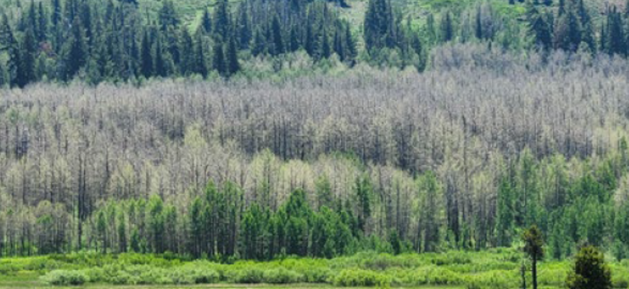
Satin Moth - Leucoma salicis
The non-native satin moth continues to defoliate individual stands of aspen around the State

Slide 6
Modoc Budworm – Choristoneura viridis
Caused shoot damage across several thousand acres in the Warner Mountains

Slide 7
Oystershell Scale – Lepidosaphes ulmi
A non-native insect contributing to aspen decline in Arizona
Identified for the first time in California near Big Bear Lake in San Bernardino County

Slide 8
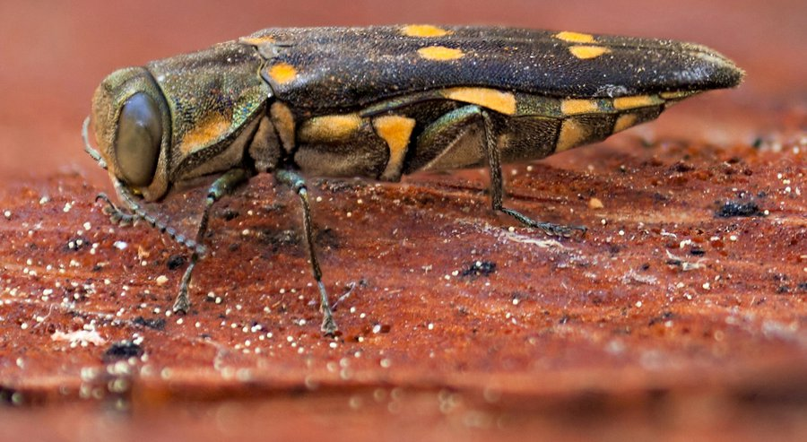
Goldspotted Oak Borer – Agrilus auroguttatus
Increasing activity throughout range.
New infestation Los Angeles County.
Entered Ventura County for the first time.

Slide 9
Invasive Shothole Borer Complexes – Euwallacea spp./Fusarium spp.
Continuing to kill trees throughout southern California
The infestation in San Jose is spreading through the City in both riparian areas and street trees
The new Greater Shothole borer was found in Santa Cruz County

Slide 10
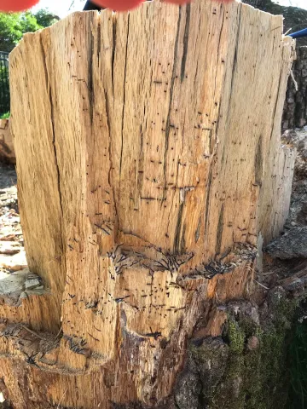
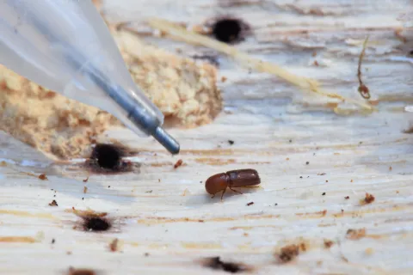
Mediterranean Oak Borer – Xyloborus monographus
Main infestation (Napa, Lake, Sonoma Counties) has spread into Mendocino County
The Sacramento County infestation is spreading rapidly in the County and has crossed into Yolo and possibly El Dorado Counties
New infestation in Oregon

Slide 11
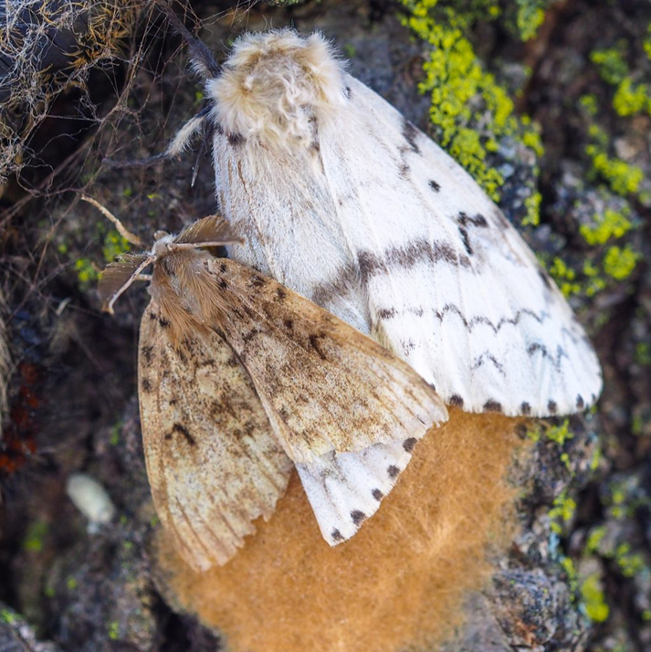
Spongy Moth – Lymantria dispar
16 male moths caught in traps in Calabasas, Los Angeles County.
Delimitating traps there and in Monte Nido, Los Angeles County, where treatment will begin soon.
Few other trap catches around California.

Slide 12
Dotted Paropsine Leaf Beetle – Paropsis atomaria
Heavy infestations on various species of Eucalyptus in Los Angeles and Riverside Counties

Slide 13
Armillaria Root Disease – Armillaria spp.
Prolific fruiting of the various species of Armillaria, particularly in the North Coastal region of California

Slide 14
Heterobasidion Root Disease – Heterobasidion spp.
Heterobasidion root disease remains common throughout California on numerous conifer species.
Often the first indication is either bark beetle attack or tree failure.

Slide 15
Sudden Oak Death Disease – Phytophthora ramorum
Mortality levels were low but are expected to increase this year.
NA2 variant of the disease is becoming more common
Del Norte County is now officially considered infested with all three known strains of the pathogen found in close proximity

Slide 16
Pitch Canker Disease – Fusarium circinatum
Pitch canker has become widespread in the Torrey Pines State Preserve in La Jolla, San Diego County
The disease has yet to be found in the only other stand of Torrey Pines on Santa Rosa Island in the Channel Islands National Park

Slide 17
Tubakia – Tubakia californica
On oaks and tanoaks.
Some local severe infections but rates appear to be lower than in previous years.
Symptoms appear related to both weather conditions at the time of potential infection and water stress at the time of disease expression.

Slide 18
Calonectria Leaf and Twig Blight – Calonectria californiensis
Mostly on bay laurels in the North Coast.
Likely related to heavy precipitation
Can lead to mortality when combined with other stress factors.

Slide 19
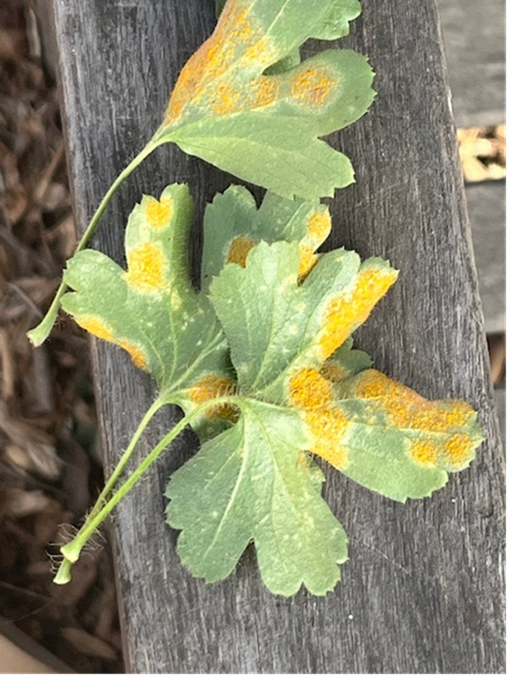
White Pine Blister Rust – Cronartium ribicola
Becoming widespread on the eastern side of the Sierra Nevada Range for the first time in higher elevation five needle pines.
Found on the alternate host (Ribes) in Los Angeles County
Not yet found in the ancient bristlecone pine forest but…

Slide 20
Acute Oak Decline – various bacteria
Continues to be found in more parts of California from the far south through Pinnacles National Park.
Several northern California potential sites are being checked.
Research is just beginning on the issue.

Slide 21
Chlorophyll Photobleaching
Found on Ficus trees in southern California
Caused by prolonged exposure to sunlight.
Mostly a problem on heavily pruned trees with other predisposing factors.
Abiotic condition.

Slide 22
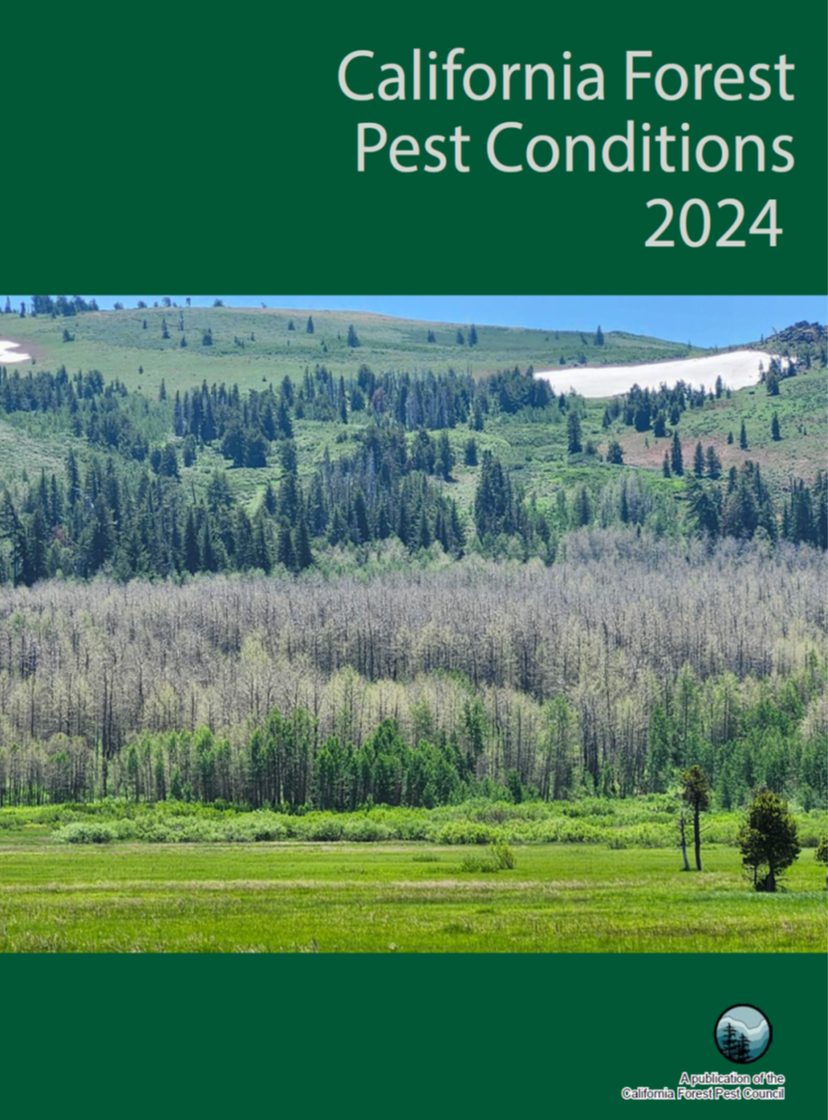
Questions?

