Slide 1

Zone Zero
Private Property Example
Lisa Worthington
California Licensed Landscape Architect #5879

Slide 2

Established in 1899 Frank Law Olmstead

Slide 3
California licensed Landscape Architects (Division 3, Chapter 3.5 BPC Section 5615-5615) are licensed professionals by the California Architects Board – Landscape Architecture Committee in compliance with Landscape Architect’s Practice Act, which includes education and licensure eligibility at the National level under the Council of Landscape Architectural Registration Boards (CLARB), and five exams, the National Landscape Architect Registration Examination (LARE) and the California Supplemental Examination (CSE) to practice in California.
  Legal Practice and Administration
  Land Grading and Stormwater Drainage
  Site Planning and Design Plan Preparation
  CEQA/NEPA Environmental Analysis and Compliance
  Construction Estimation and Specifications
  Construction Detail Preparation
  California-Specific Standards, including Water Conservation, Energy Conservation
Applying the Zone Zero standards to a private property (example) was a voluntary effort to use knowledge, skills and abilities from professional practice to a Property Level - Wildfire Mitigation Discount program (State Farm)

Slide 4
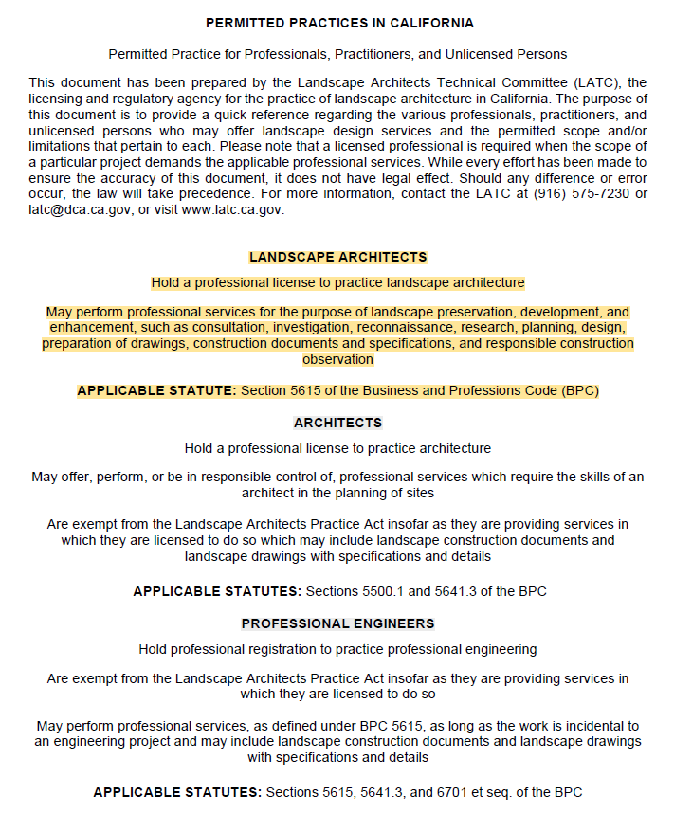
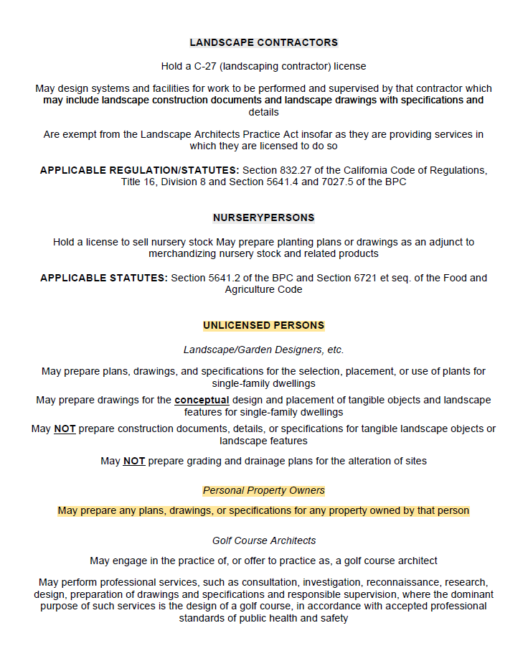

Slide 5
Where do I begin?
Start walk-around “360 planning”
Obtain legal parcel map and review property boundaries
Understand basic Municipal Land Use law for private property and regulations related to local jurisdiction
Communicate 1:1 with adjacent property owners
Evaluate natural resource protection requirements
Notes:
360 Planning = plan for a 10-month schedule of working days allowing for planning, design, estimating, permitting, contracting, materials purchase and weather delays
Obtain parcel map from County Tax Assessor and evaluate deed allowances/restrictions with a certified title officer.
If legal property lines are disputable, consider hiring a California licensed Land Surveyor to provide written concurrence of recorded parcel map and a survey with field marking (“staking”) of legal property boundary to avoid violating municipal land use law.
Communicate 1:1 with adjacent property owners regarding property lines, overall schedule and scope of upcoming Zone Zero work.
Obtain local jurisdictional natural resource protection requirements, (i.e., watercourse setbacks, protection of native tree species, exterior lighting and noise limitations;

Slide 6
Disclaimer
Property owners have intrinsic rights to modify their landscape, but renters of property do not without the owner’s written permission
State law requires vegetative clearing up to 100’ from the structure in Zones to establish defensible space, ending at the legal property line.
Zones are measurable
The first 0-5’ around a home are especially vulnerable to ignition
Residential property owner is the recorded “owner-of-record,” available through the County tax assessor
Property-level fire risk scores are not public information. A property’s Fire Factor (risk score) is assigned by a homeowner’s insurance company. More specific probabilistic risk of wildfire is based on vegetation, topography and fire weather in the surrounding area.

Slide 7
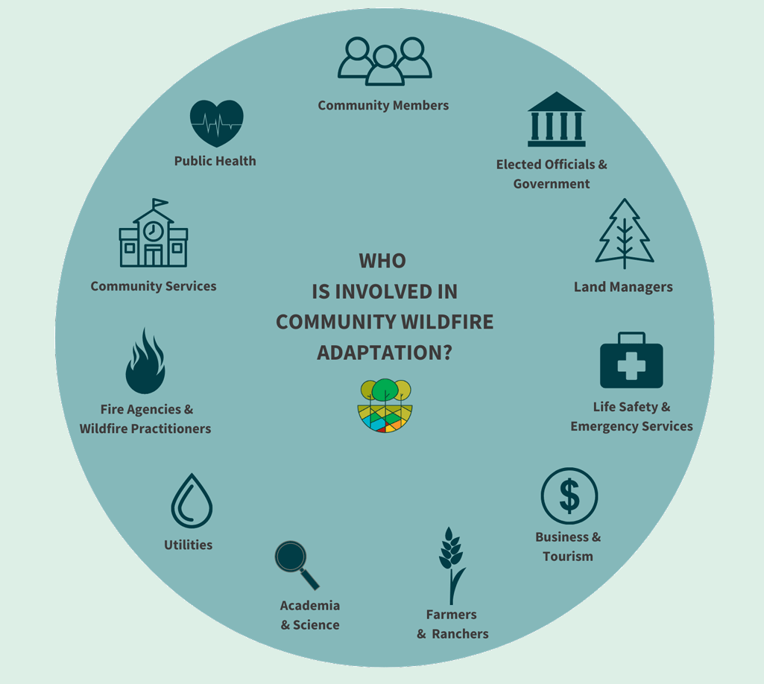
Wildfire Adaptation
Collective Action - Community Members

Slide 8
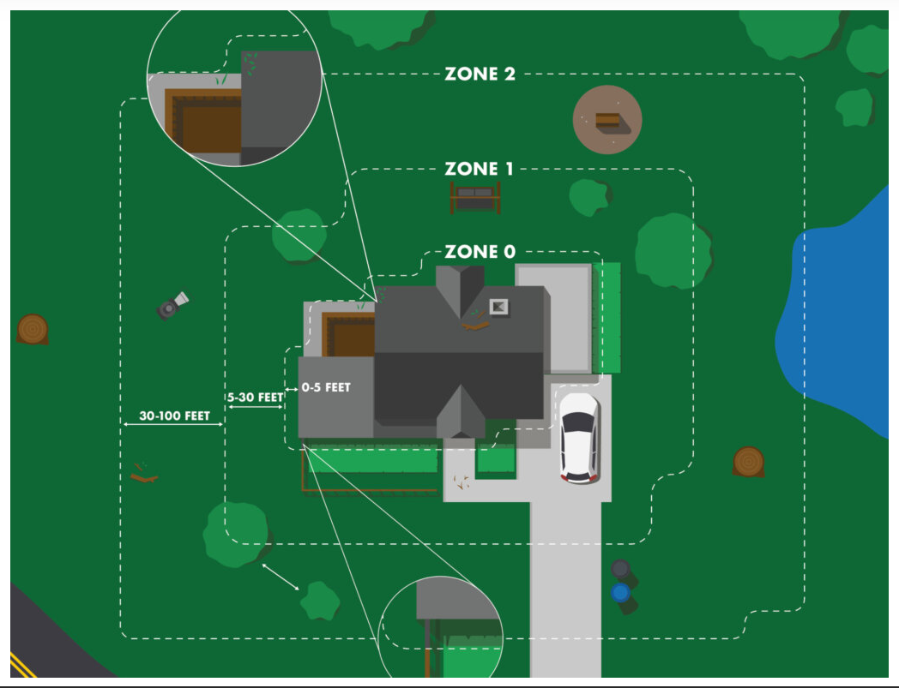
Wildfire Adaptation
Zone Zero =
Property Level Adaptation

Slide 9
Example Property
1 Year (2023)
Placer County, City of Auburn
HOA 227 +/- homes adjacent to 40,000 acres State Park lands in American River Canyon
Fire Wise Community Certification completed for perimeter of neighborhood
Home values $650,000 - $1.2M
Neighborhood includes Moderate and High Fire Hazard Severity Zone (FHSZ) areas
All Zone Zero principles were considered in redesign
Property size = .45 acre 150’ x 126’
5 months - $9,000 Home Hardening elements completed first (August to December)
7 months – $13,000 Zone Zero Defensible Space elements completed (January to July)
Total budget - $22,000

Slide 10
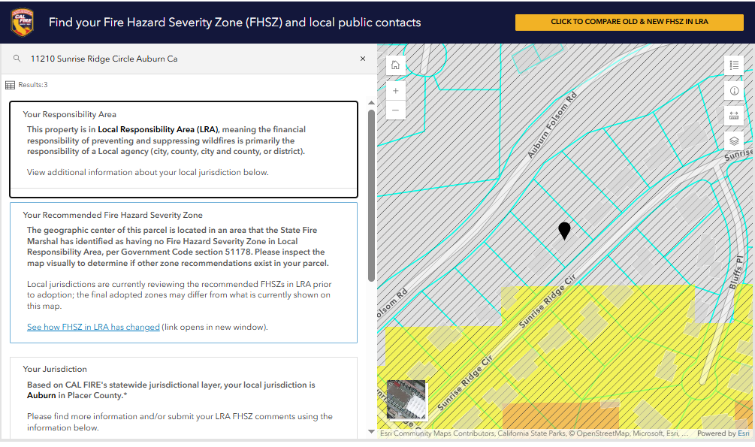
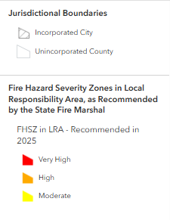
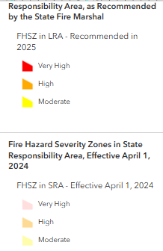

Slide 11
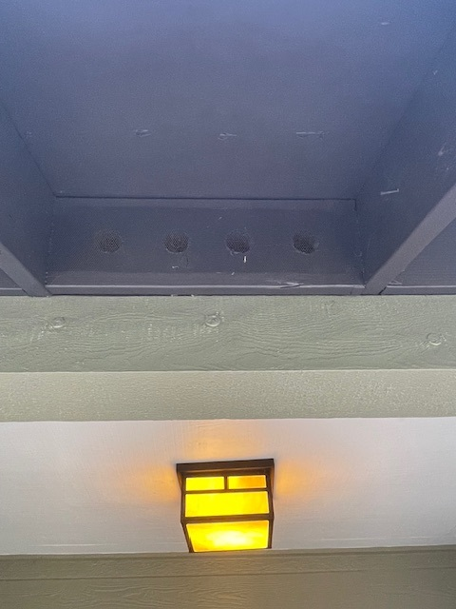
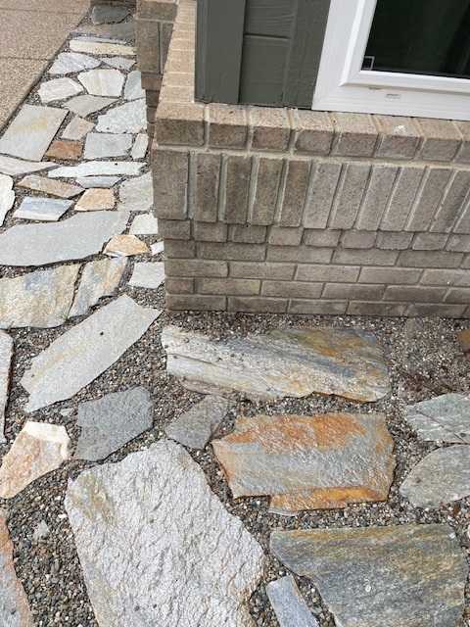
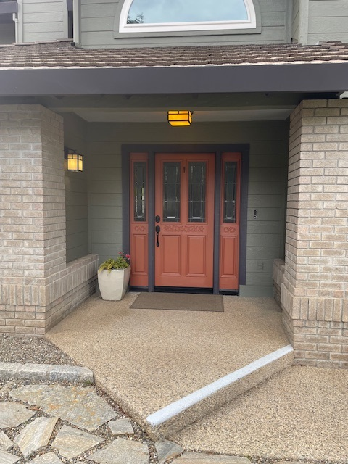

Slide 12
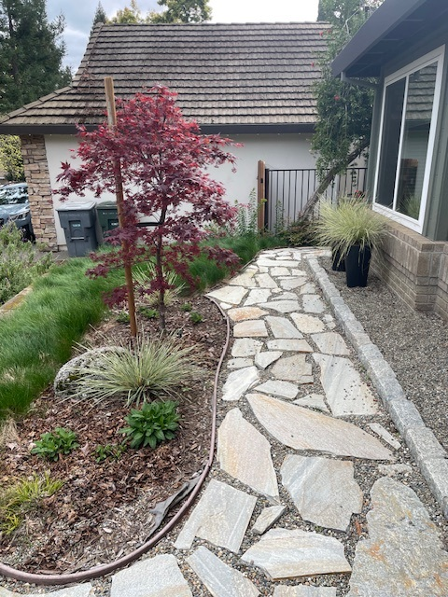
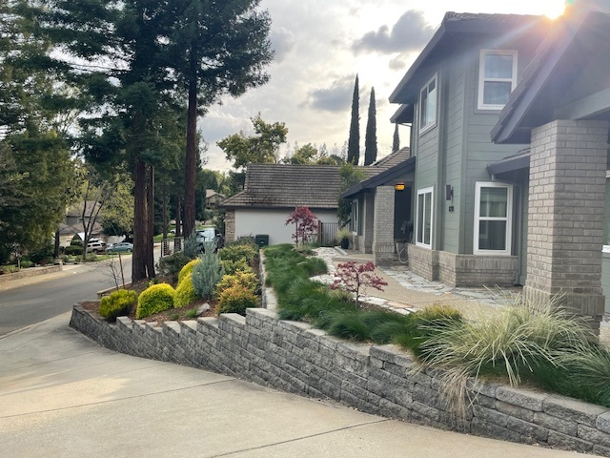

Slide 13
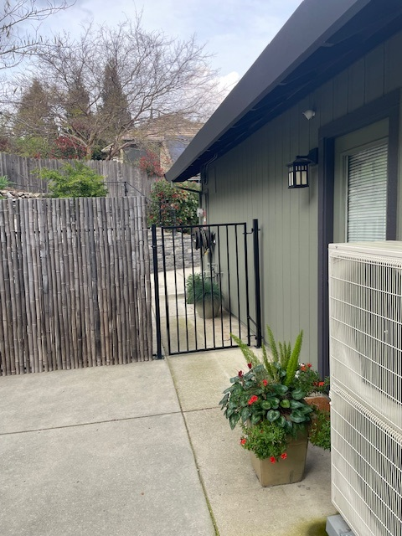
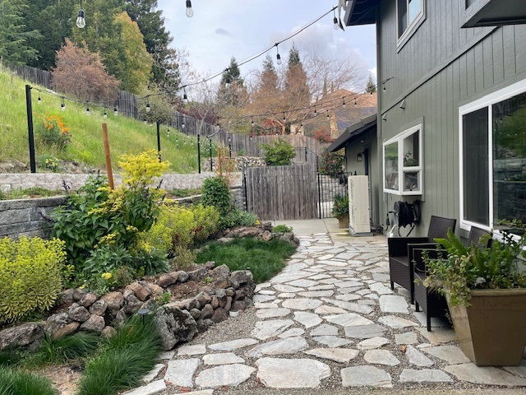

Slide 14
Example Property
Zone Zero Scope of Work – STEP 1
Stake property lines and 5’ Zone Zero boundaries around entire structure
Complete 511 underground utility line marking
Complete 360 walk-thru and identify weaknesses
Determine risk tolerance, budget, time frame, hiring professionals to support adaptation vision
Maximize focus and investment in Zone Zero plus expand active outdoor space
Target other benefits, such as reducing irrigation water use by atleast 50% property-wide
Evaluate pathways/circulation patterns – opportunity to widen or add ADA compliance

