Slide 1
Fire Hazard Severity Zones
(FHSZ)

Slide 2
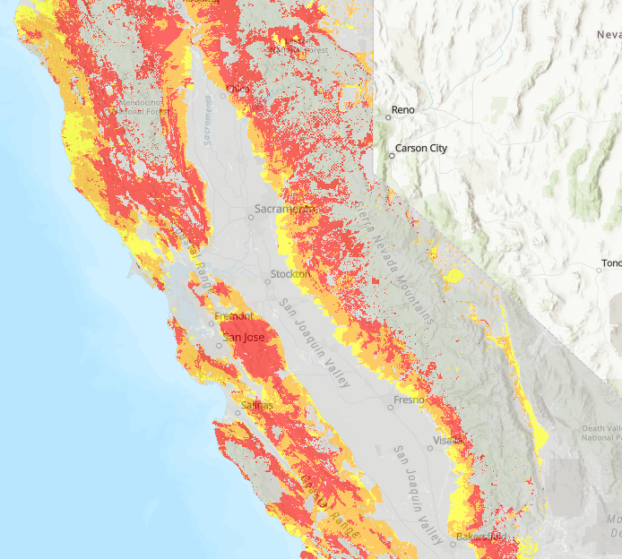
Fire Hazard Severity maps recognize areas of increased fire danger in California.
CAL FIRE recently updated these maps, making them available to the public on their website.
www.Fire.CA.Gov
Notes:
IBHS’ testing facility has demonstrated how wind-carrying embers deflect from a structure and collect within 5 feet of its base. The goal, which is to prevent fire propagation within Zone 0, must be followed up with the tactic of creating a dead zone for embers to burn out.

Slide 3
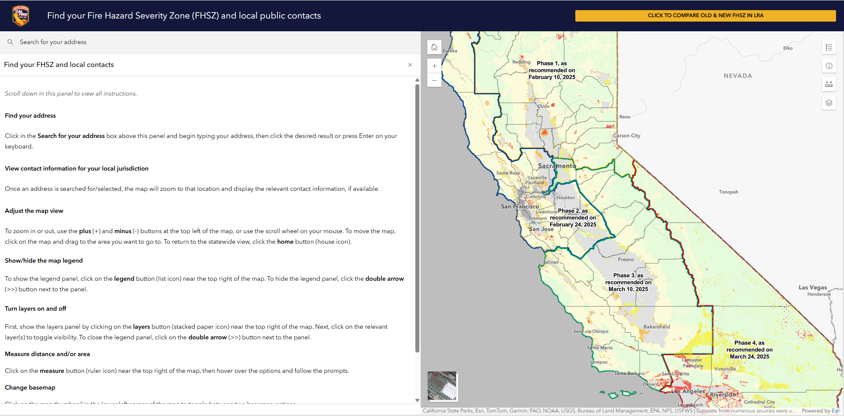
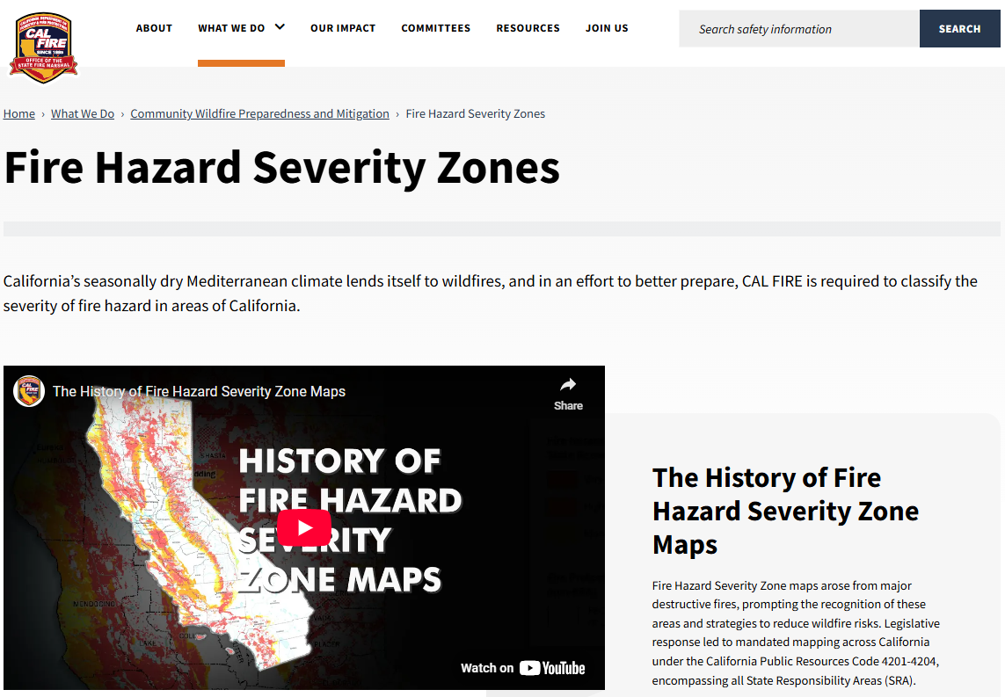
FHSZ Resources
Interactive FHSZ Map
FHSZ Website
Notes:
Links are active

Slide 4
Ignition Resistant ZONE 0
Information and statistics

Slide 5
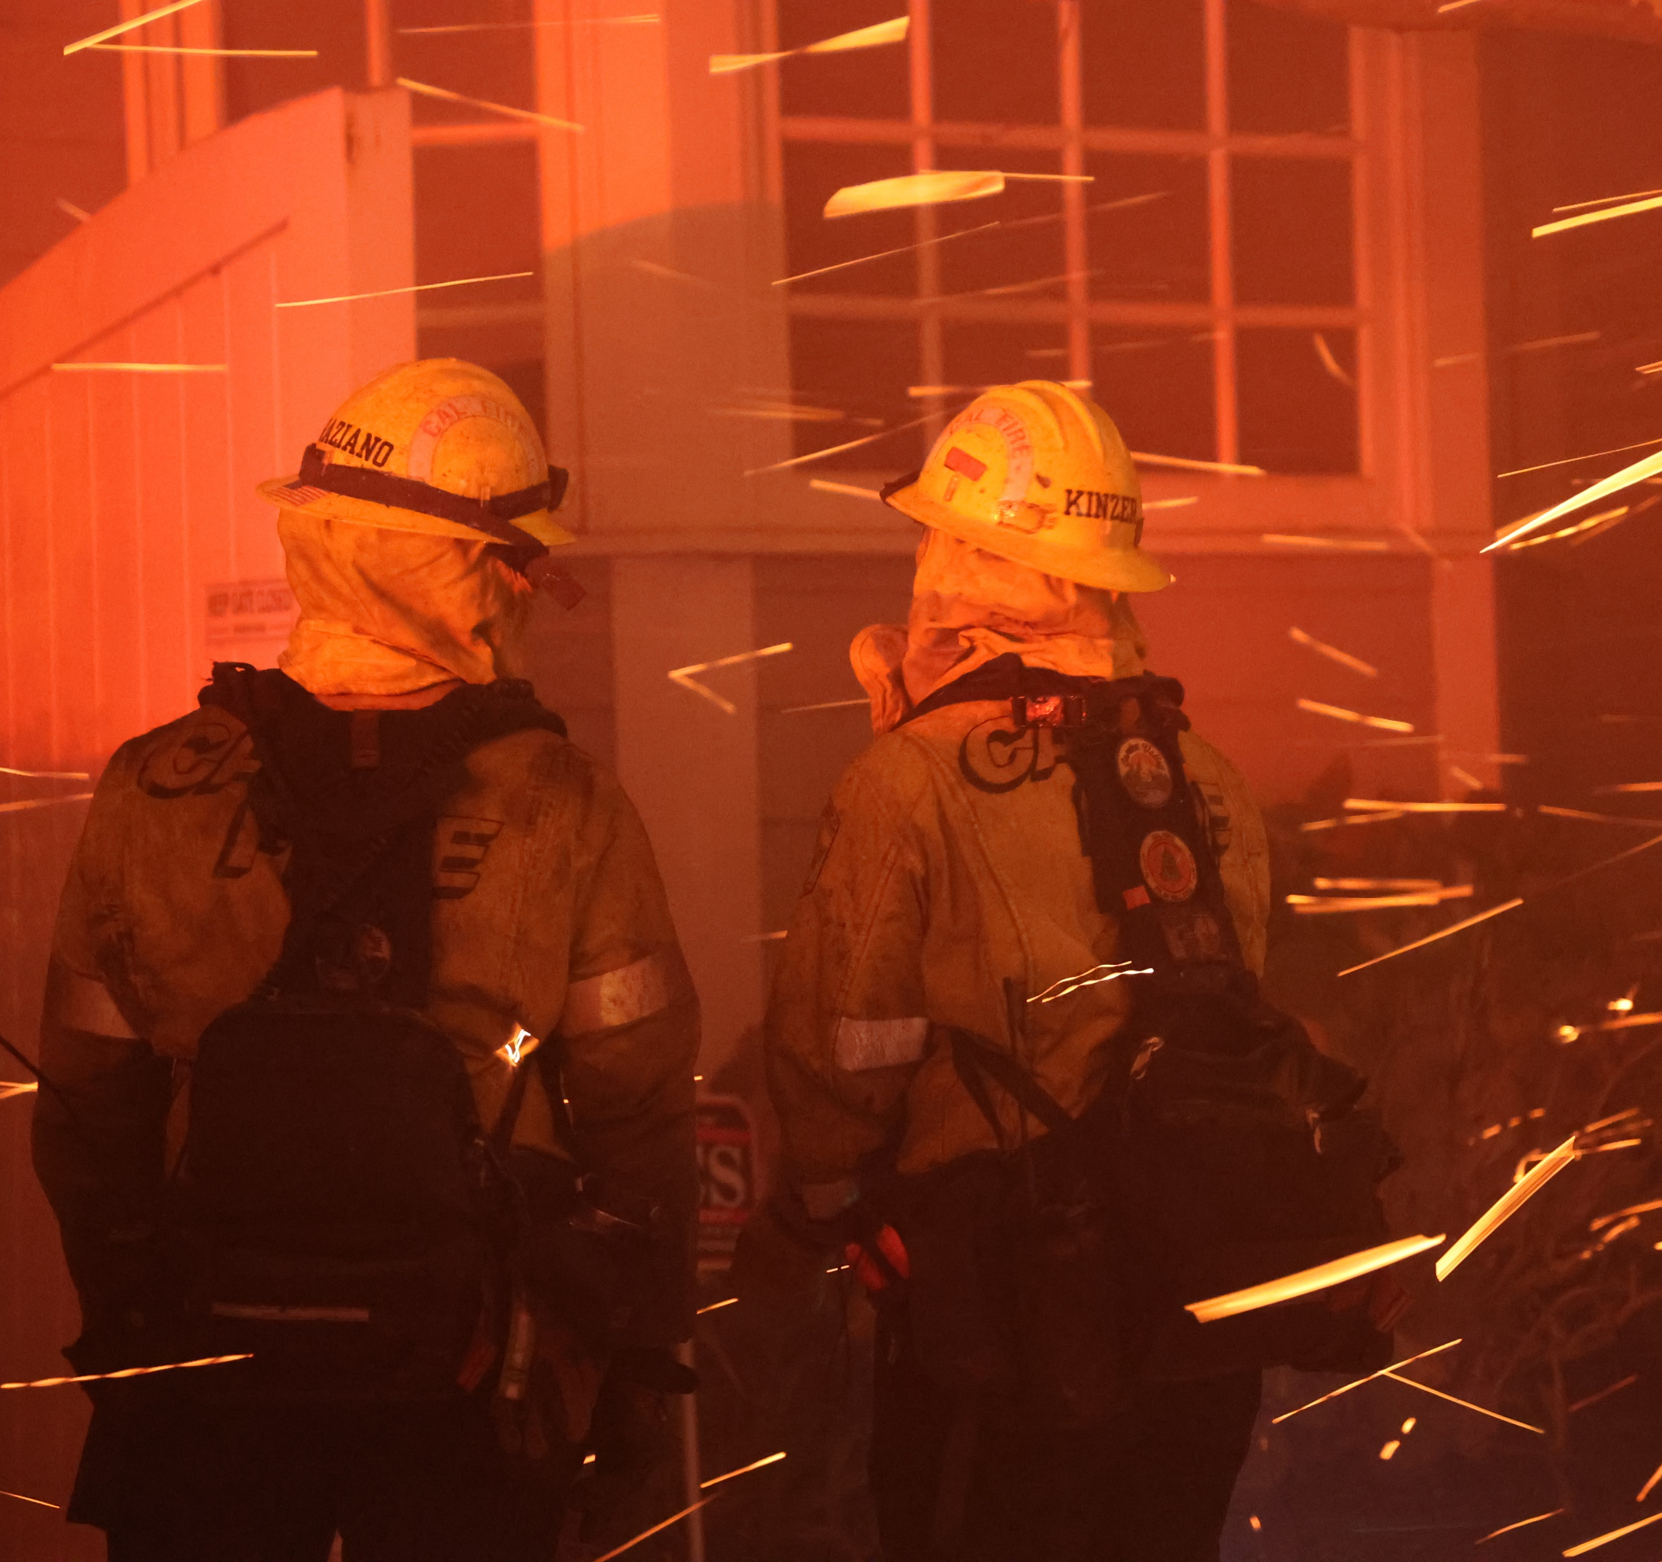
Zone 0 is a critical component of structure defense and, when coupled with Zones 1 and Zone 2, is essential to defensible space.
Notes:
IBHS’ testing facility has demonstrated how wind-carrying embers deflect from a structure and collect within 5 feet of its base. The goal, which is to prevent fire propagation within Zone 0, must be followed up with the tactic of creating a dead zone for embers to burn out.

Slide 6
Zone 0: 5-ft non-combustible Buffer
Remove all vegetation, including overhanging branches
Remove wood mulch
Remove combustible fences
Replace with rock, pavers, or stepping stones.

Slide 7
Zone 0 reduces the likelihood of structure ignition by reducing the potential for direct ignition of the structure…
from flame contact, by embers that accumulate at the base of a wall,
and/or indirect ignitions when embers ignite vegetation, vegetative debris, or other combustible materials located close to the structure.
that result in either a radiant heat/or a direct flame contact exposure to the structure
Photo Credit - IBHS
Notes:
Science has been able to replicate reality. Wind-driven fires carry embers from far or near, but the collection point is at the base of the structure.

Slide 8
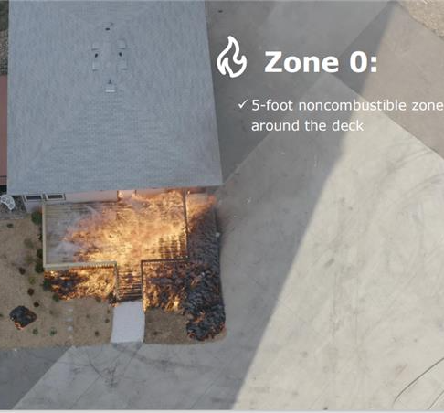
Photo Credit - IBHS
Notes:
Damage Inspection data has stated the connection of an attached deck or porch being the fire pathway to the structure, but this can be minimized if the fire pathway to the combustible deck or porch is interrupted by creating Zone 0 and eliminating combustible vegetation and or other materials. The IBHS photo on the left illustrates the need to remove combustible vegetation within 5 feet of the deck.

Slide 9
Damage Inspection Data: Construction feature vulnerability
Notes:
ANIMATION SLIDE. Click ONCE for highlight.
Fence construction features are: Combustible – Non-Combustible – No Fence
Attached FENCES to structures have contributed to the structure loss
Brewer – How many years or structures does this chart represent?
Zone 0 will interrupt that fire pathway to the structure as the current rule plead reads

Slide 10
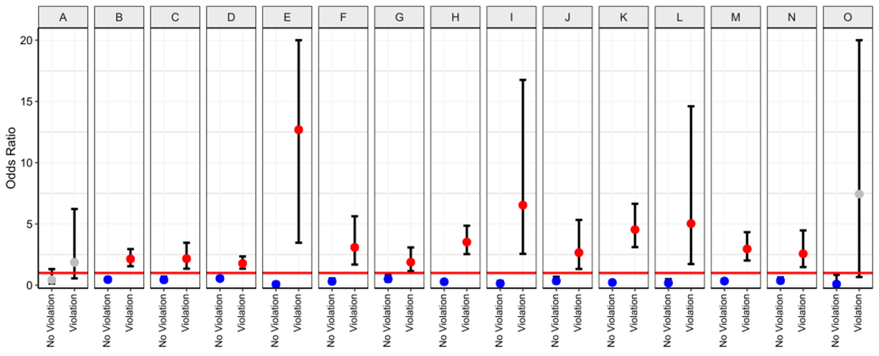
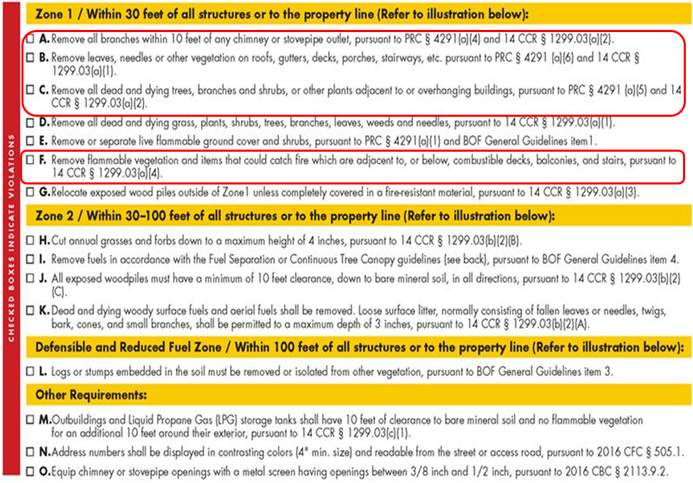
Camp Fire Defensible Space and Damage Inspection Overlay Data –Brewer to confirm
Notes:
ANIMATION SLIDE. Click 1 time to bring in panel
The data overlay is displaying the relationship of defensible space violations compared to destroyed structures
Columns A through O are the current defensible space regulations with some additional requirements
Zone 0 will transition requirements A,B,C, and F into the new Zone 0.
What the last three slides illustrate best is that each mitigation action taken, EIGHT in total, reduces risk and creates links in the chain of resiliency for homeowners. And when replicated throughout a neighborhood, defensible space transforms from a parcel-level change to a communal-level change.

Slide 11
Zone 0 Resources
www.fire.ca.gov/dspace
www.readyforwildfire.com/prepare
Notes:
Links are active

