Slide 1
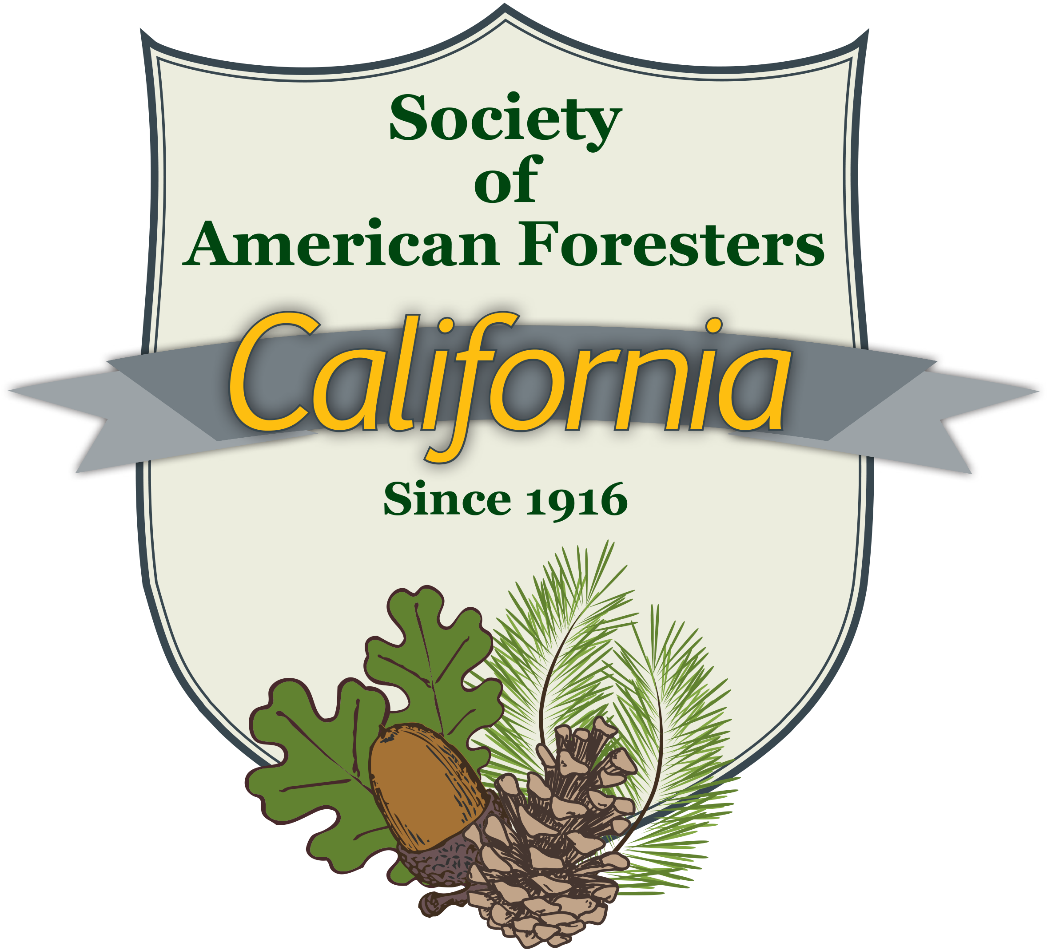
California Society of American Foresters
Position on California’s Wildfire Emergency
Presentation to California Board of Forestry and Fire Protection
August 21, 2019
Nicholas Dennis, Ph.D., RPF – Principal Author

Slide 2
Position Statements On Wildfire Emergency
For about 35 years, California has faced a wildfire crisis as the frequency and intensity of large wildfires have steadily increased
In recent years, this crisis has become an emergency, as wind-driven crown fires have increasingly burned into cities and towns, killing dozens of residents and causing billions of dollars in annual damages
The California Society of American Foresters has adopted these position statements
California’s Wildfire Emergency
The Role of Mechanical Treatments in Reducing the Risk of Catastrophic Wildfires in California
The Social Benefits of a Robust Woody Biomass Energy Market in California

Slide 3
Focus on Forest Management
The wildfire emergency is a complex, multi-faceted problem that involves a wide range of government, social, and institutional issues
These position statements focus on the forest management issues related to the wildfire emergency
They also address non-forest management issues, but in these areas our recommendations are restricted to widely-accepted, common-sense ideas

Slide 4
Spatial Model of Wildfire Emergency
The forest management context of the wildfire emergency can be considered as a series of concentric circles surrounding our cities and towns at risk of wildfire
CA SAF’s strategy focuses on treating hazardous fuels near cities and towns, because that is where loss of life and property damages are concentrated
The strategy extends outward from cities and towns at risk to include all forestlands

Slide 5
Spatial Model of Wildfire Emergency
City
Town
WUI
WUI
WUI
Gateway Forest
Gateway Forest
Remote Forest

Slide 6
Scope of Problem and Solution Strategy
Approximately 15% of the state’s population lives in areas at high or extreme risk of wildfire
Cities and towns can best be protected by constructing fuelbreaks in gateway forests
Most cities and town at risk are surrounded by wildland-urban interface (WUI) areas
The WUI can best be protected by creating defensible space throughout the WUI and by constructing fuelbreaks in gateway forests
The fire resilience of much of California’s remote forestland has declined substantially due to historical processes
Although fires in remote forests usually do not threaten residential areas, they impose huge costs on metropolitan California through smoke-related air pollution and impairment of water supplies and quality
The pace and scale of management of remote forests must be increased substantially to restore fire resilience to our remote forests and reduce wildfire damages of acceptable levels
The main forest management techniques available to reduce fire hazards are mechanical treatments, prescribed fire, and managed wildfire

Slide 7
Fuelbreaks, Defensible Space, and Structural Hardening
Research has confirmed the effectiveness of fuelbreaks in reducing fire intensity and resulting tree mortality
The main objective of both fuelbreaks and defensible space is to impede the tree-to-tree transmission of crown fires, force the fire to the ground, and enable fire fighters to directly attack the fire
Equally important to reducing hazardous fuels is “hardening” of residences against fire by building homes with fireproof exterior materials and screening openings to prevent airborne embers from entering the house

Slide 8
Need to Modify Forest Structure in Residential Areas and Near Infrastructure
There is universal consensus that forest structures must be modified in residential areas to protect them from wildfires, as codified in PRC section 4290
CA SAF believes similar forest structure modifications are required adjacent to powerlines and highways in very high wildfire hazard zones

Slide 9
SB 901 and Support for Biomass Energy Industry
SB 901 authorizes up to $200 million annually primarily for reducing hazardous fuels
A more economically efficient approach to reducing fire hazards than direct payments for fuel treatments is to subsidize the state’s biomass energy industry
High costs of processing and transporting small trees limit the economic feasibility of woody biomass energy production
Hauling wood chips more than 30 miles each way generally makes the overall operation a net cost
Expanding the state’s biomass energy capacity by investing in existing and new facilities would increase the feasibility of fuel treatments
Co-benefits of a robust biomass energy industry include economic stimulus to the state’s impoverished rural areas

Slide 10
4290 Inspections and Local Hazardous Vegetation Ordinances
Residential inspections conducted pursuant to Section 4290 by CalFire and its sister agencies are a sound means of reducing fire hazards in WUI areas
We must increase the rigor of all aspects of the inspection process, including better training of inspectors, better record keeping, better follow-up of non-conformance items, and more aggressive prosecution of persistent non-conformance items
Local hazardous vegetation ordinances may be needed to compel WUI landowners to implement fuel treatments needed to reduce wildfire risks throughout the community

Slide 11
Increasing Power of Insurance Industry
The insurance industry is becoming an increasingly powerful force in determining which WUI parcels and subdivisions remain inhabited
residential inspections of hazardous fuels, a parallel process to 4290 inspections
policy renewals contingent on compliance with hazardous fuel abatement measures
sharp premium increases
renewal denials
As homes in areas at risk of wildfire become uninsurable, they decline value and may become uninhabitable

Slide 12
Need for Better Initial Detection and Emergency Warning Systems
Recommended non-forest management approaches to reducing wildfire damages include
Increased use of cameras, drones, and satellites to ensure early detection of wildfire ignitions, especially on red flag days
Installation of improved community emergency warning systems

Slide 13
Emergencies Call For Ambitious Goals
The state has set a goal of implementing 500,000 acres of fuel treatments annually on private land
Region 5 of the Forest Service has also set a goal of implementing 500,000 acres of fuel treatment annually on federal land
Achieving these goals will require the sustained commitment of public resources and strong alliances of stakeholders
CA SAF supports the state’s initiatives to solve the wildfire emergency and wants to be a partner in implementing the solution

Slide 14
California Society of American Foresters
For further information on this presentation, please contact
Nick Dennis
NicholasLDennis@gmail.com
(530) 859-0822
For further information on CA SAF, please visit: CaliforniaSAF.org

