Slide 1
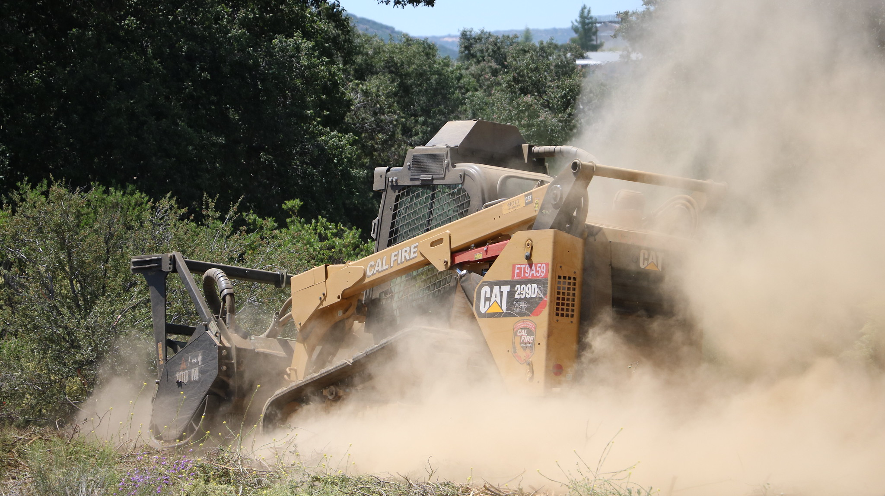
Fire Risk
Reduction
Community List

Slide 2
FRRCL 2022
Region | Number of Applications | Amount Requested | Number of Awarded | Amount Awarded
CNR | 25 | $ 57,503,970.26 | 12 | $ 11,339,605.69
CSR | 16 | $ 24,027,385.09 | 3 | $ 7,622,295.00
Totals | 41 | $ 81,531,355.35 | 15 | $ 18,961,900.69

Slide 3
Activity Type
2022
CAL FIRE Region | Amount Funded | Number of Awards
Hazardous Fuels Reduction | $18,077,602.98 | 12
CNR | $10,806,965.58 | 10
CSR | $7,270,637.40 | 2
Wildfire Prevention Education | $351,657.60 | 1
CSR | $351,657.60 | 1
Wildfire Prevention Planning | $532,640.11 | 2
CNR | $532,640.11 | 2
Grand Total | $18,961,900.69 | 15

Slide 4
FRRCL 2023
Region | Number of Applications | Amount Requested | Number of Awarded | Amount Awarded
CNR | 11 | $ 11,723,252.55 | 5 | $ 6,170,648.05
CSR | 20 | $ 23,417,607.07 | 11 | $ 14,094,524.55
Totals | 31 | $ 35,140,859.62 | 16 | $ 20,265,172.60

Slide 5
Activity Type
2023
CAL FIRE Region | Amount Funded | Number of Awards
Hazardous Fuels Reduction | $19,328,175.08 | 14
CNR | $6,170,648.05 | 5
CSR | $13,157,527.03 | 9
Wildfire Prevention Education | $803,755.68 | 1
CSR | $803,755.68 | 1
Wildfire Prevention Planning | $133,241.84 | 1
CSR | $133,241.84 | 1
Grand Total | $20,265,172.60 | 16

Slide 6
Questions

