Slide 1
Ember Resistant Zone Zero Overview of Draft Rule Plead
May 12, 2025

Slide 2
Overview
Existing Text for Zone 1 and Zone 2
Proposed Changes to March 21 rule text.

Slide 3
Existing Requirements for Zone 1 and 2 per PRC 4291
The baseline text of these regulations has been in place in the current form since 2013.
Because of this, these regulations do not consider an ember-resistant zone – there is no Zone 0.
This current regulatory text considers Zone 1 as 0’-30’ from a Building or Structure, and Zone 2 as 30’-60’ from a Building or Structure.
The changes in this text are conforming changes that move things out of Zone 1 that now apply to Zone 0 (within 5 feet from a Building or Structure)

Slide 4
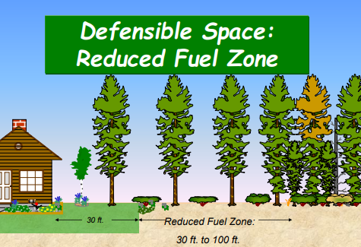
Zone 1 and 2 Diagram
This image is from the 2013 Guidance Document “General Guidelines for Creating Defensible Space”.

Slide 5
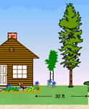
Zone 1 Requirements
(1) Remove all dead or dying grass, plants, shrubs, trees, branches, leaves, weeds, and pine needles from the Zone whether such vegetation occurs in yard areas around the “Building or Structure,” on the roof or rain gutters of the “Building or Structure,” or any other location within the Zone.

Slide 6
Zone 1 Requirements
(2) Remove dead tree or shrub branches that overhang roofs, below or adjacent to windows, or which are adjacent to wall surfaces, and keep all branches a minimum of ten feet (10 ft.) away from chimney and stovepipe outlets.
(3) Relocate exposed firewood piles outside of Zone 1 unless they are completely coverenclosed in a fire-resistant material .
(4) Remove flammable vegetation and items that could catch fire which are adjacent to or under combustible decks, balconies and stairs.

Slide 7
For both Zones 1 and 2:
(1) “Outbuildings” and Liquid Propane Gas (LPG) storage tanks shall have the following minimum clearance: ten feet (10 ft.) of clearance to bare mineral soil and no flammable vegetation for an additional ten feet (10 ft.) around their exterior.
(2) Protect water quality. Do not clear vegetation to bare mineral soil and avoid the use of heavy equipment in and around streams and seasonal drainages. Vegetation removal can cause soil erosion, especially on steep slopes. Keep soil disturbance to a minimum on steep slopes.

Slide 8
Zone 2 Requirements
(1) In this zone, create horizontal and vertical spacing among shrubs and trees using the “Fuel Separation” method, the “Continuous Tree Canopy” method, or a combination of both to achieve defensible space clearance requirements. Further guidance regarding these methods is contained in the State Board of Forestry and Fire Protection's, “General Guidelines for Creating Defensible Space, February 8, 2006,” incorporated herein by reference, and the “Property Inspection Guide” referenced elsewhere in this regulation.

Slide 9
From the General Guidelines for Creating Defensible Space, February 8, 2006
(2) In both the Fuel Separation and Continuous Tree Canopy methods the following standards apply:
(A) Dead and dying woody surface fuels and aerial fuels shall be removed. Loose surface litter, normally consisting of fallen leaves or needles, twigs, bark, cones, and small branches, shall be permitted to a maximum depth of three inches (3 in.).
(B) Cut annual grasses and forbs down to a maximum height of four inches (4 in.).
(C) All exposed wood piles must have a minimum of ten feet (10 ft.) of clearance, down to bare mineral soil, in all directions.

Slide 10
From the General Guidelines for Creating Defensible Space, February 8, 2006
1. Single specimens of trees or other vegetation may be retained provided they are well spaced, well-pruned, and create a condition that avoids spread of fire to other vegetation or to a building or structure.

Slide 11
From the General Guidelines for Creating Defensible Space, February 8, 2006
2. Dead and dying woody surface fuels and aerial fuels within the Reduced Fuel Zone shall be removed. Loose surface litter, normally consisting of fallen leaves or needles, twigs, bark, cones, and small branches, shall be permitted to a depth of 3 inches. This guideline is primarily intended to eliminate trees, bushes, shrubs and surface debris that are completely dead or with substantial amounts of dead branches or leaves/needles that would readily burn.

Slide 12
From the General Guidelines for Creating Defensible Space, February 8, 2006
3. Down logs or stumps anywhere within 100 feet from the building or structure, when embedded in the soil, may be retained when isolated from other vegetation. Occasional (approximately one per acre) standing dead trees (snags) that are well-space from other vegetation and which will not fall on buildings or structures or on roadways/driveways may be retained.

Slide 13
From the General Guidelines for Creating Defensible Space, February 8, 2006,
4. Within the Reduced Fuel Zone, one of the following fuel treatments (4a. or 4b.) shall be implemented. Properties with greater fire hazards will require greater clearing treatments. Combinations of the methods may be acceptable under §1299(c) as long as the intent of these guidelines is met:

Slide 14
From the General Guidelines for Creating Defensible Space, February 8, 2006,
4. Within the Reduced Fuel Zone, one of the following fuel treatments (4a. or 4b.) shall be implemented. Properties with greater fire hazards will require greater clearing treatments. Combinations of the methods may be acceptable under §1299(c) as long as the intent of these guidelines is met:

Slide 15
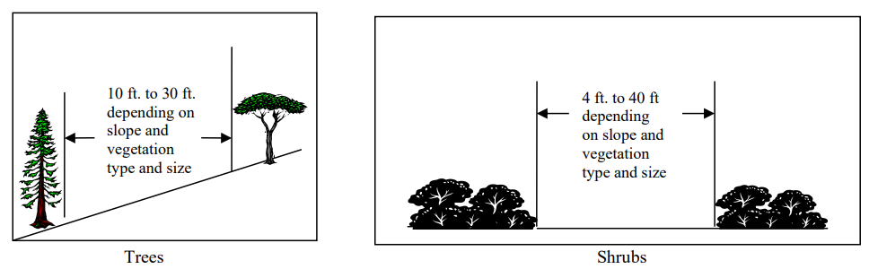
From the General Guidelines for Creating Defensible Space, February 8, 2006,
4a. Reduced Fuel Zone: Fuel Separation
Defines permitted distances between trees and shrubs

Slide 16
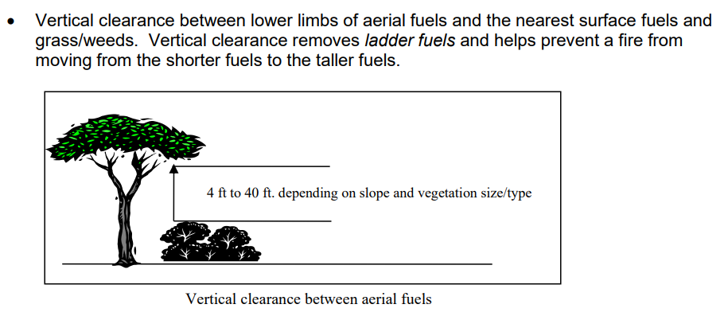
From the General Guidelines for Creating Defensible Space, February 8, 2006,
4a. Reduced Fuel Zone: Fuel Separation
Defines ladder fuel height

Slide 17
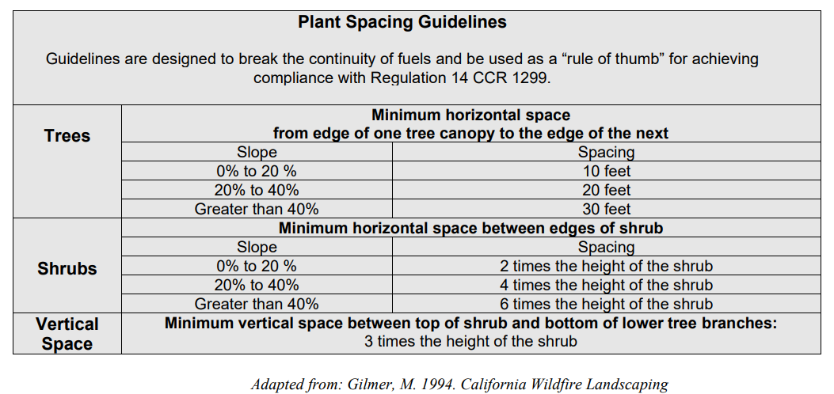
From the General Guidelines for Creating Defensible Space, February 8, 2006,
4a. Reduced Fuel Zone: Fuel Separation

Slide 18
4b. Reduced Fuel Zone: Defensible Space with Continuous Tree Canopy
To achieve defensible space while retaining a stand of larger trees with a continuous tree canopy apply the following treatments:
• Generally, remove all surface fuels greater than 4 inches in height. Single specimens of trees or other vegetation may be retained provided they are well-spaced, well-pruned, and create a condition that avoids spread of fire to other vegetation or to a building or structure.
• Remove lower limbs of trees to at least 6 feet up to 15 feet (or the lower 1/3 branches for small trees). Properties with greater fire hazards, such as steeper slopes or more severe fire danger, will require pruning heights in the upper end of this range.

Slide 19
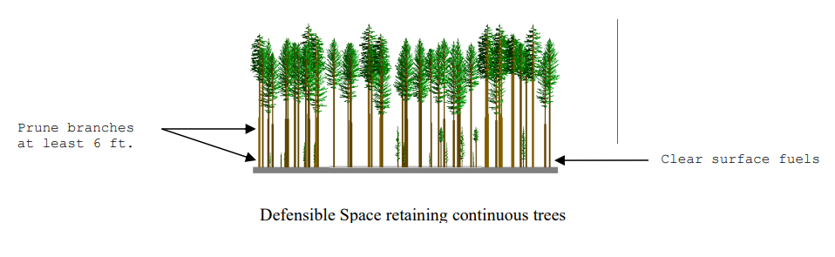
From the General Guidelines for Creating Defensible Space, February 8, 2006,
4b. Reduced Fuel Zone: Defensible Space with Continuous Tree Canopy

Slide 20
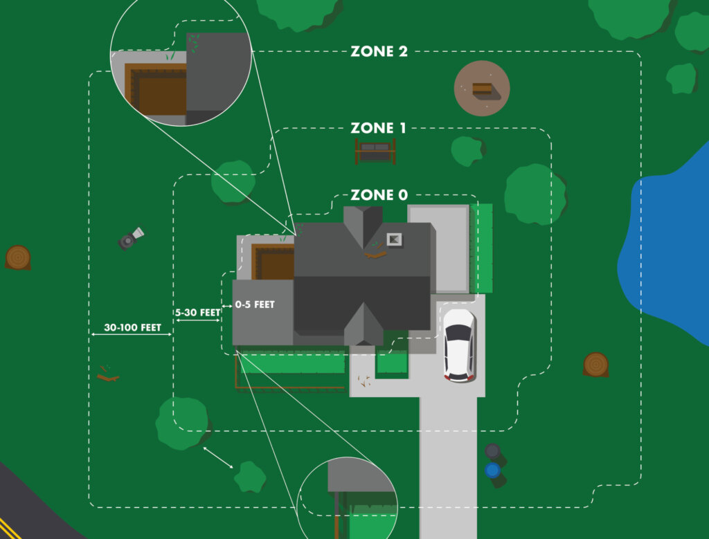
Ember Resistant Zone Zero Rule Plead
Concerns area within five (5’) feet around each Building or Structure
Also makes conforming changes to Zone One (5’-30’) a Building or Structure

Slide 21
Proposed Changes to March 21 Rule Text
Plain text indicates existing regulatory text – no changes are proposed to this text.
Underlined text indicates proposed additions to the regulatory text
Strikethrough text indicates proposed deletions from the regulatory text
Red text is text that has been changed since the March 21 draft. It will have underline and strikethrough as appropriate

Slide 22
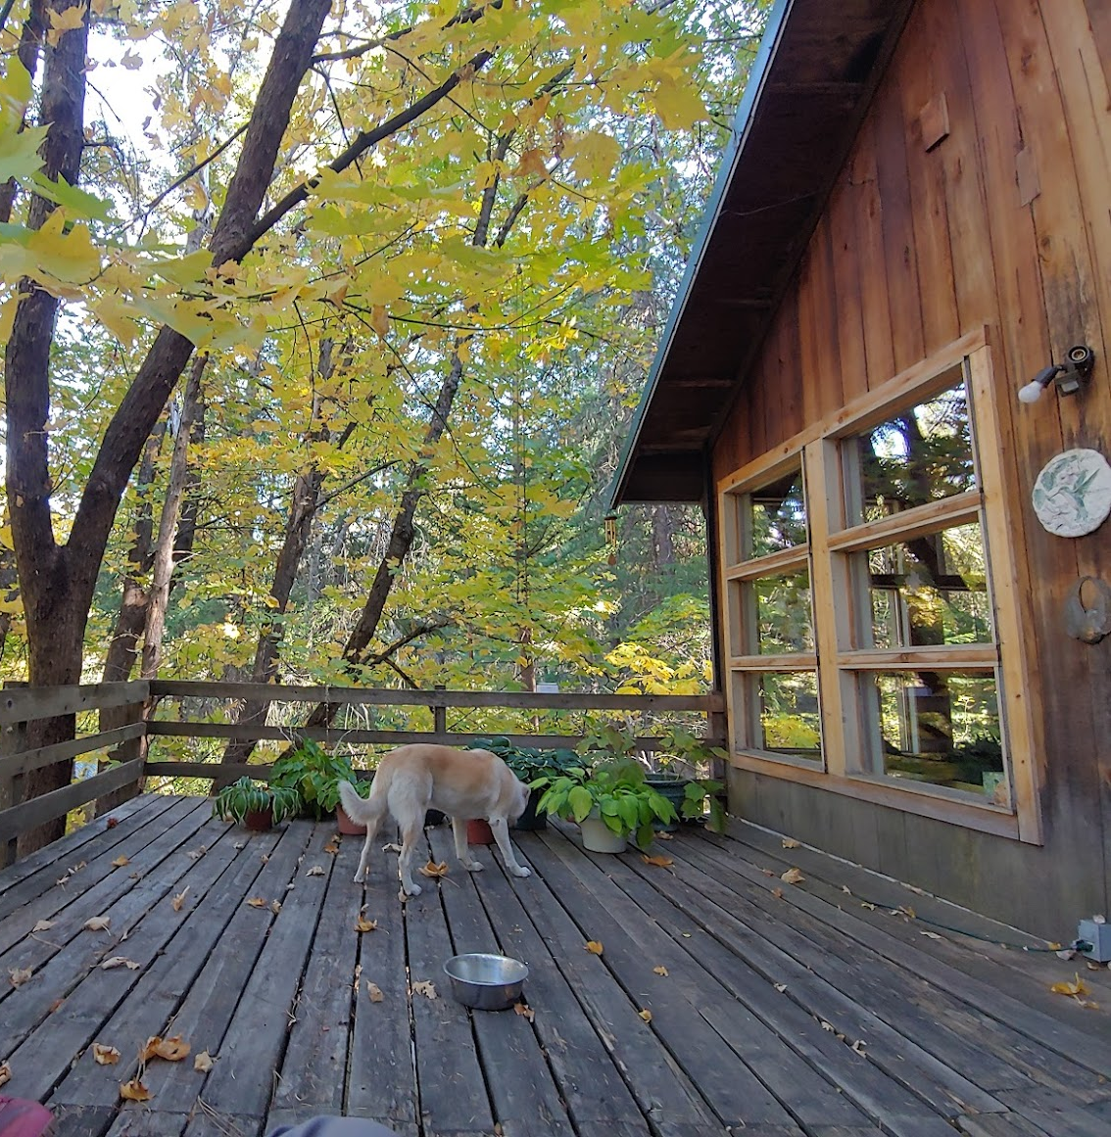
§ 1299.02. Definitions
(g) Attached: Directly connected or affixed to a Building or Structure.
(h) Roof Ridgeline: The highest point of a roof.

Slide 23
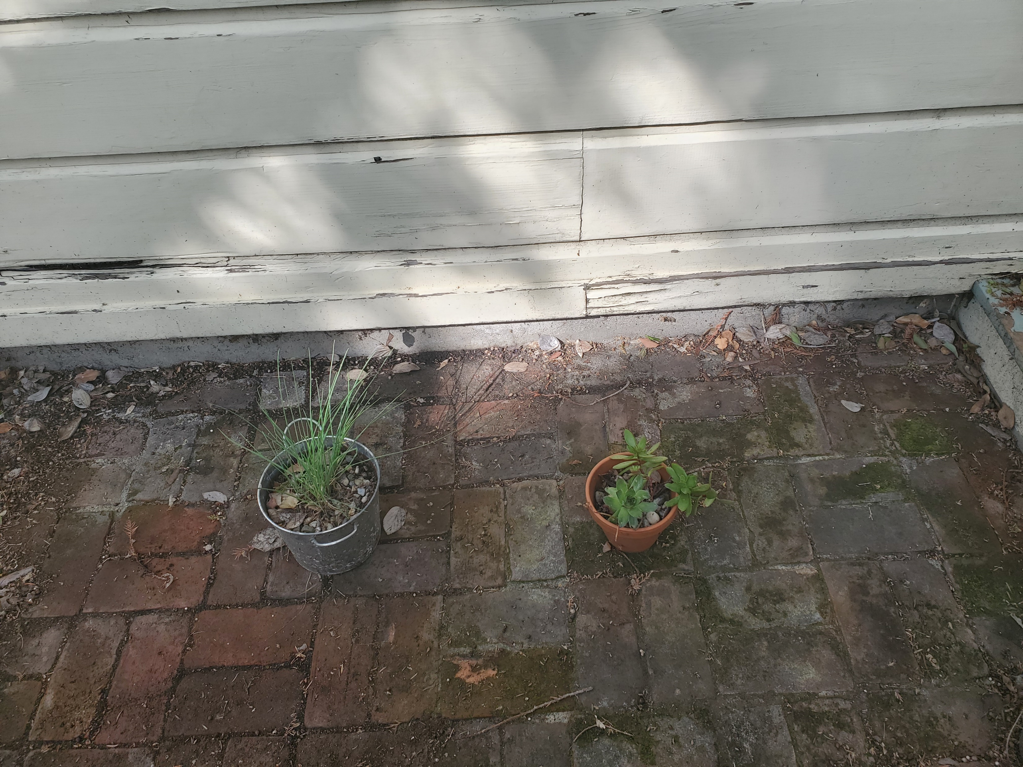
Potted Plants
(A) Exception: Ten (10) or fewer plants in pots are allowable if they are in areas that are not directly beneath, above, or in front of adjacent to a window, glass door, or vent; are kept in an unaffixed, not combustible pot or container that is no larger than 5-gallon capacity; and set apart by 1.5 times the height of the plant or 12 inches, whichever is greater, from the structure and each other. These plants shall be no greater than 18 inches in height. Dead or dying material on the plants shall be removed. Potted plants shall be moved out of Zone 0 on red flag warning days.

Slide 24
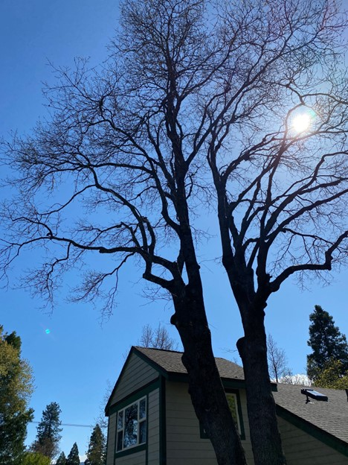
Trees
(2) Trees within Zone 0 are permitted if: No trees are permitted in Zone 0.
(A) Exception: for Buildings or Structures with fewer than three stories: If the bole of a tree is present within Zone 0, a tree is permitted if it is taller than the adjacent Building or Structure’s roof ridgeline and does not have any dead and dying branches. All live tree branches shall be kept ten feet (10’) above the adjacent Building or Structure’s roof ridgeline, ten feet (10’) away from chimneys and stovepipe outlets, and five feet (5’) away from the sides of any Building or Structure.

Slide 25
Trees
(2) (B) Exception: for Buildings or Structures with three or more stories and without balconies or decks a tree is permitted if the bole of a tree is present within Zone 0, if it does not have any dead and dying branches; and all live tree branches shall be kept ten feet (10’) above the adjacent Building or Structure’s roof, ten feet (10’) away from chimneys and stovepipe outlets, and five feet (5’) away from the sides of any Building or Structure.

Slide 26
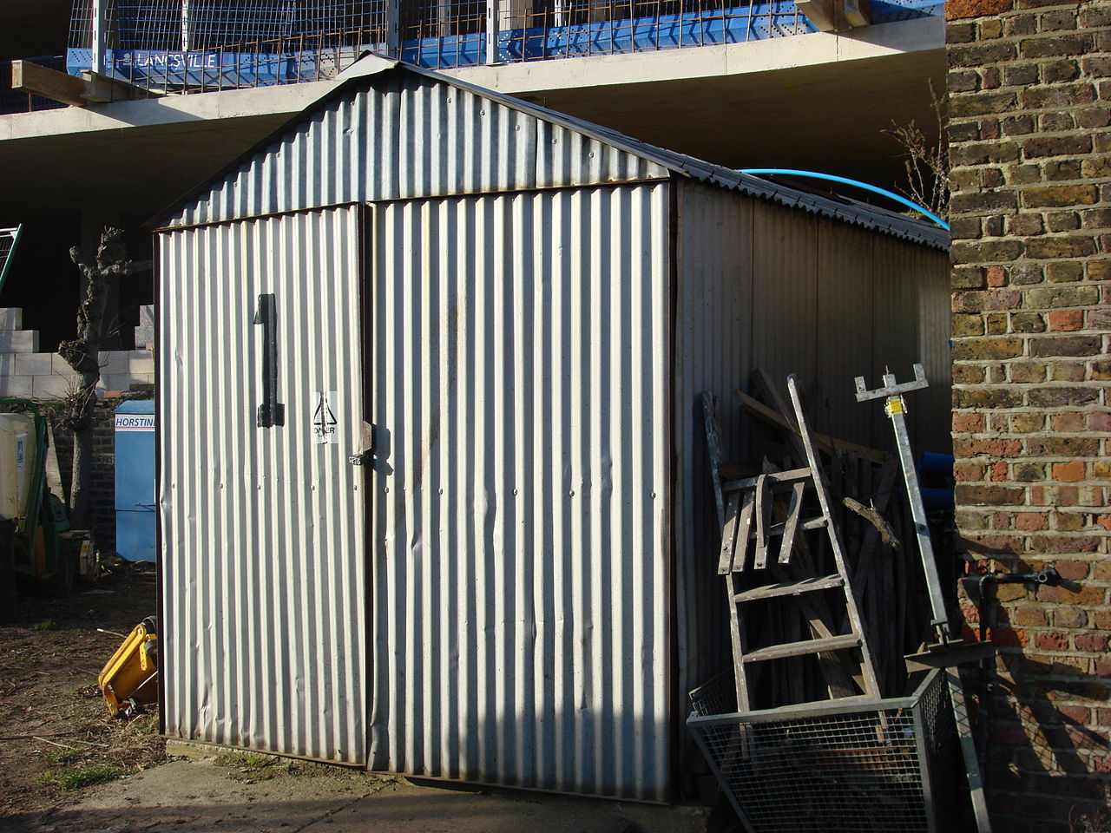
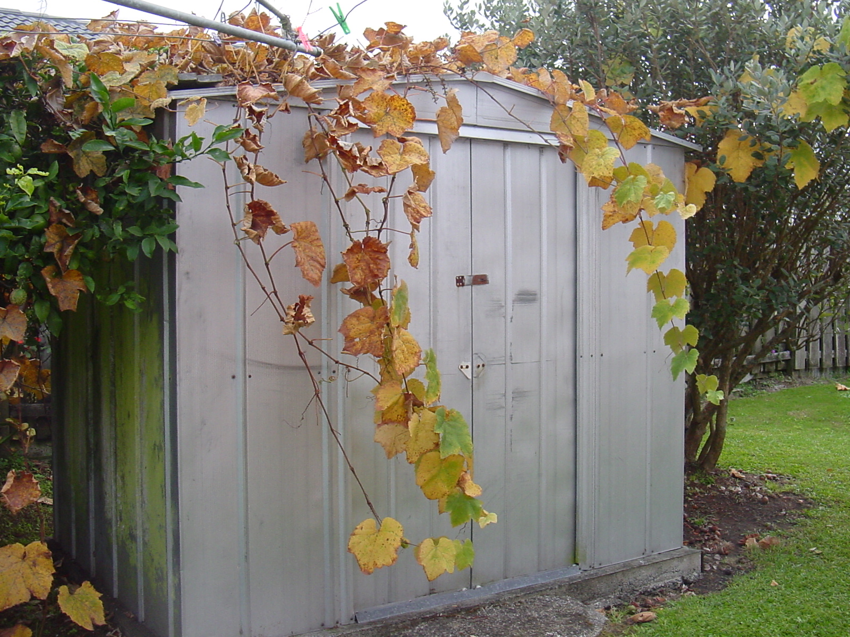
Outbuildings
6) Outbuildings are not permitted in Zone 0, unless constructed according to the standards in Chapter 7A (commencing with Section 701A.1) of Part 2 of Title 24 of the California Code of Regulations. Outbuildings that meet these standards shall be considered part of the Building or Structure for purposes of determining Zones 0, 1, and 2.

Slide 27
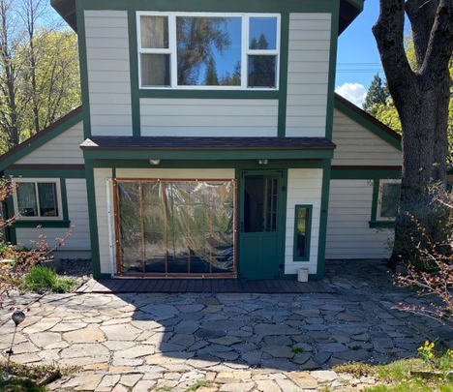
Staging
(8) The Department may allow for the staging of work for existing structures and take into account the scope of work necessary to achieve compliance.
(8) For existing structures, the Department may allow the staging of work to support implementation of Zone 0 and address the costs of compliance.

Slide 28
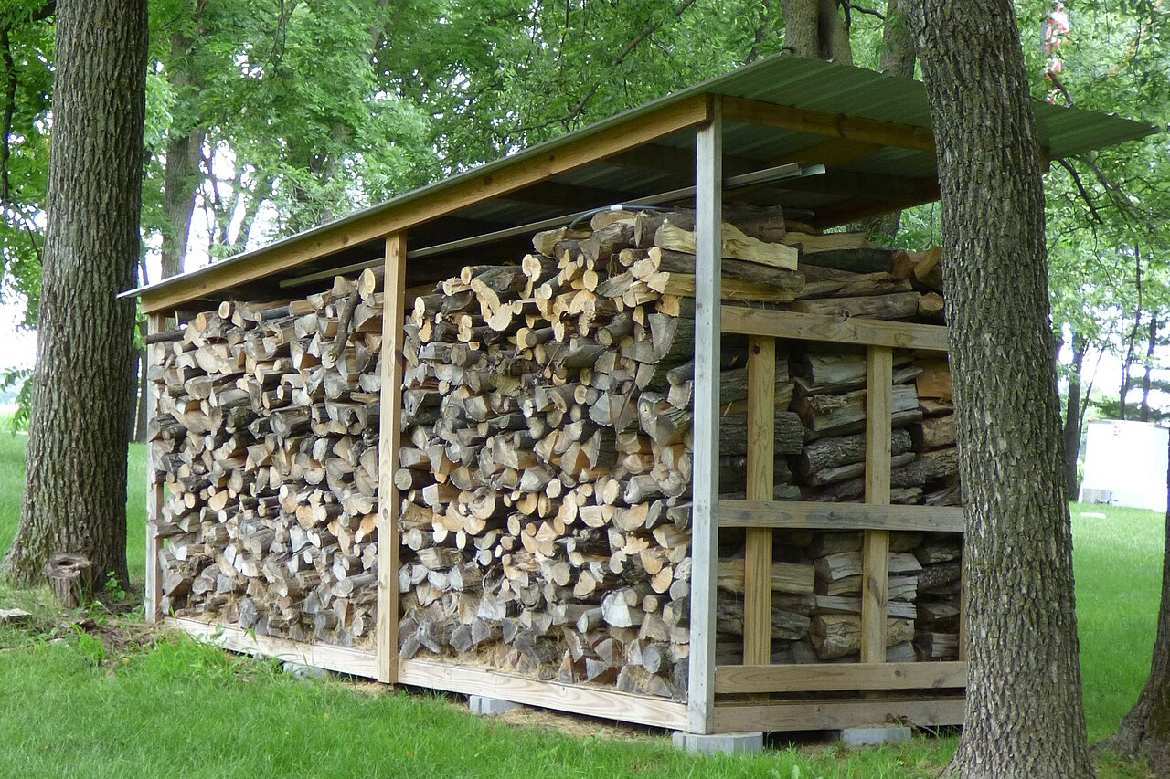
Zone 1 Change
(3) Relocate exposed firewood piles outside of Zone 1 unless they are completely coverenclosed in a fire-resistant material.

Slide 29
Thank you for your Input
Email: PublicComments@bof.ca.gov
Website: www.bof.fire.ca.gov
Next Committee Meeting, June 16
Sacramento, California

Slide 30

Commenting
To submit a verbal comment, select the “Raise Hand” icon - it is circled below in blue. The presenter will call your name and enable your microphone, you will then need to unmute yourself by selecting the microphone, circled in red below. If you have technical issues, please discuss them in the “Chat” pane, circled in green in the graphic below.

Slide 31

Workshop will resume at: 1:00 PM

Slide 32
Next Steps
May Workshop
Finance Review
Public Comment Period
Public Hearing
Response to Comments
Board Approves FSOR and Rule Plead
Regulation Effective
Board Approves Draft Rule Text and ISOR
Submit Rulemaking Package
OAL Review
Regulations Filed

Slide 33
Ember Resistant Zone Zero
The Board’s authority to adopt these regulations is authorized by PRC § 4291
Some specific changes within the rule plead are required by changes to the authorizing statute
There are changes where the Board has more discretion as to the content of the rule plead

Slide 34
Ember Resistant Zone Zero
The language in the rule plead must meet the requirements of the Administrative Procedures Act for clarity, consistency, and necessity.

Slide 35
Changes to Regulatory Text
Plain text indicates existing regulatory text
Underlined text indicates proposed additions to the regulatory text
Strikethrough text indicates proposed deletions from the regulatory text

Slide 36
§ 1299.01. Purpose.
The intent of this regulation is to provide guidance for implementation of Public Resources Code Section 4291 to improve safety for fire fighters defending a home as well as increase the survivability of a “Building or Structure” as defined, that exists in grass, brush, and forest covered lands within the designated State Responsibility Area (SRA) of California.

Slide 37
Potted Plants
(A) Exception: Plants in pots are allowable if they are in areas that are not directly beneath, above, or adjacent to a window; are kept in an unaffixed, not combustible pot or container that is no larger than 5-gallon capacity; and set apart by 1.5 times the height of the plant or 12 inches, whichever is greater, from the structure and each other. These plants shall be no greater than 18 inches in height. Dead or dying material on the plants shall be removed.

Slide 38
§ 1299.02. Definitions
(b) Building or Structure. Anything constructed that is designed or intended for support, enclosure, shelter, or protection of persons, animals, or property, having a permanent roof that is supported by walls or posts that connect to, or rest on the ground. A structure for the purpose of an ember-resistant zone includes an attached deck.

Slide 39
§ 1299.02. Definitions
(c) Outbuilding. Buildings or structures that are less than one hundred-twenty (120) square feet in size and not used for human habitation. For purposes of this Section, an “Outbuilding” is not a “Building or Structure” as defined in subsection (b) above.

Slide 40
§ 1299.02. Definitions
(d) Existing Building or Structure. An Existing Building or Structure is a Building or Structure other than a New Building or Structure.
(e) New Building or Structure. A New Building or Structure is a Building or Structure that did not exist prior to the effective date of the regulation that added this subsection.

Slide 41
§ 1299.02. Definitions
(f) Combustible: Vegetative, wood, or petroleum-based materials that are likely to ignite and transmit flames.

Slide 42
§ 1299.03. Requirements.
Defensible space is required to be maintained at all times, whenever flammable vegetative conditions exist.

Slide 43
§ 1299.03(a) Zone Definitions
(a) One hundred feet (100 ft.) of defensible space clearance shall be maintained in two three distinct “Zzones” as follows:
Zone 0 is the area within five feet (5 ft.) around each Building or Structure or to the property line, whichever comes first.
“Zone 1” extends from five (5ft.) to thirty feet (30 ft.) out from each “Building or Structure,” or to the property line, whichever comes first;
“Zone 2” extends from thirty feet (30 ft.) to one hundred feet (100 ft.) from each “Building or Structure,” but not beyond the property line.
The vegetation treatment requirements for Zone 0 are more restrictive than for Zone 1; the requirements for Zone 1 are more restrictive than for Zone 2,; as provided in this section (a) and (b) below.

Slide 44
§ 1299.03(a) Zone Definitions

Slide 45
§ 1299.03(b) Zone Zero Requirements
(1) Landscaping Materials
  Exception: Some Potted Plants
(2) Trees
  Exception: Some trees with specific pruning.
(3) Other items that are likely to be ignited by embers
(4) Combustible Gates
(5) Combustible Fences
(6) Outbuildings
(7) Timelines
(8) Staging and scope of work

Slide 46
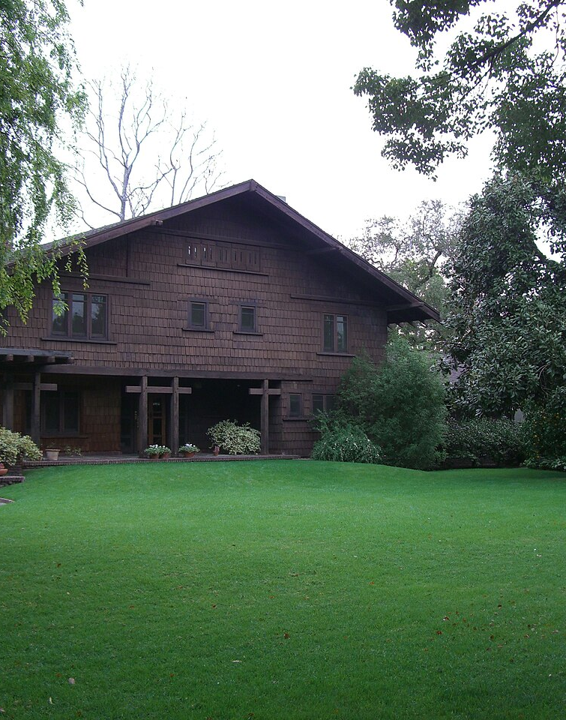
Landscaping Materials
(1) No landscaping materials that are likely to be ignited by embers are permitted within Zone 0. This includes, but is not limited to grass, ornamental or native plants, shrubs, branches, fallen leaves and tree needles, weeds, and combustible mulches including bark and woodchips.

Slide 47
Potted Plants
(A) Exception: Plants in pots are allowable if they are in areas that are not directly beneath, above, or adjacent to a window; are kept in an unaffixed, not combustible pot or container that is no larger than 5-gallon capacity; and set apart by 1.5 times the height of the plant or 12 inches, whichever is greater, from the structure and each other. These plants shall be no greater than 18 inches in height. Dead or dying material on the plants shall be removed.

Slide 48
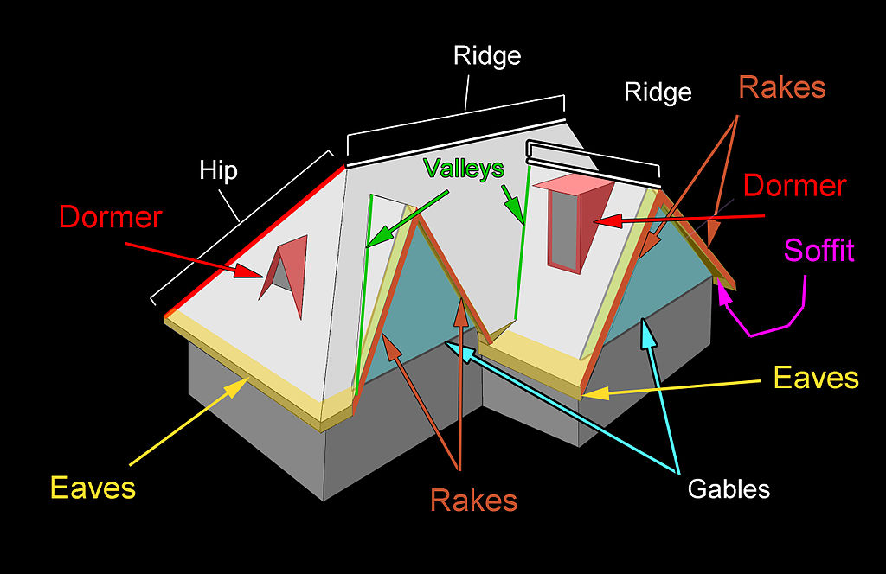
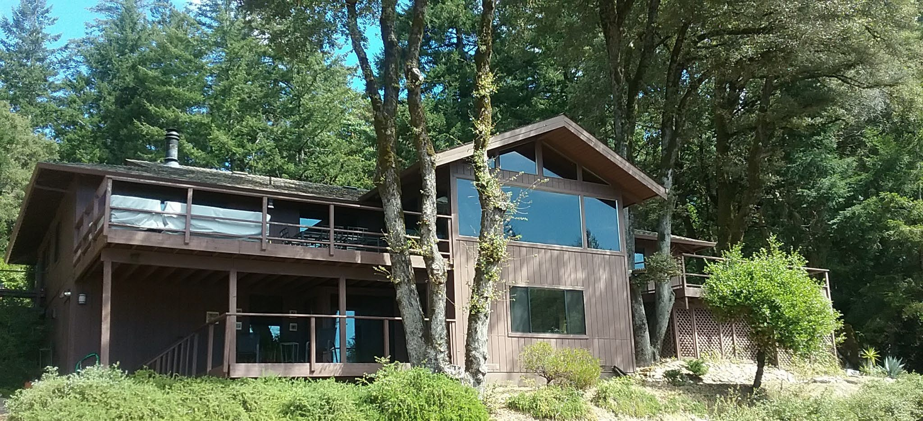
Trees
(2) No trees are permitted in Zone 0.
(A) Exception: If the bole of a tree is present within Zone 0, that tree is permitted if it is taller than the adjacent Building or Structure’s roof ridgeline, does not have any dead and dying branches; and all live tree branches shall be kept ten feet (10’) above the adjacent Building or Structure’s roof ridgeline, ten feet (10’) away from chimneys and stovepipe outlets, and five feet (5’) away from the sides of any Building or Structure.
Photo Credit: Yana Valachovic

Slide 49
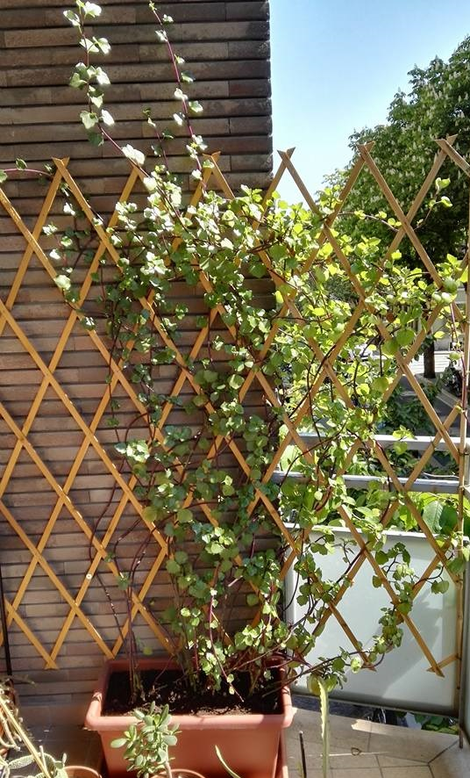
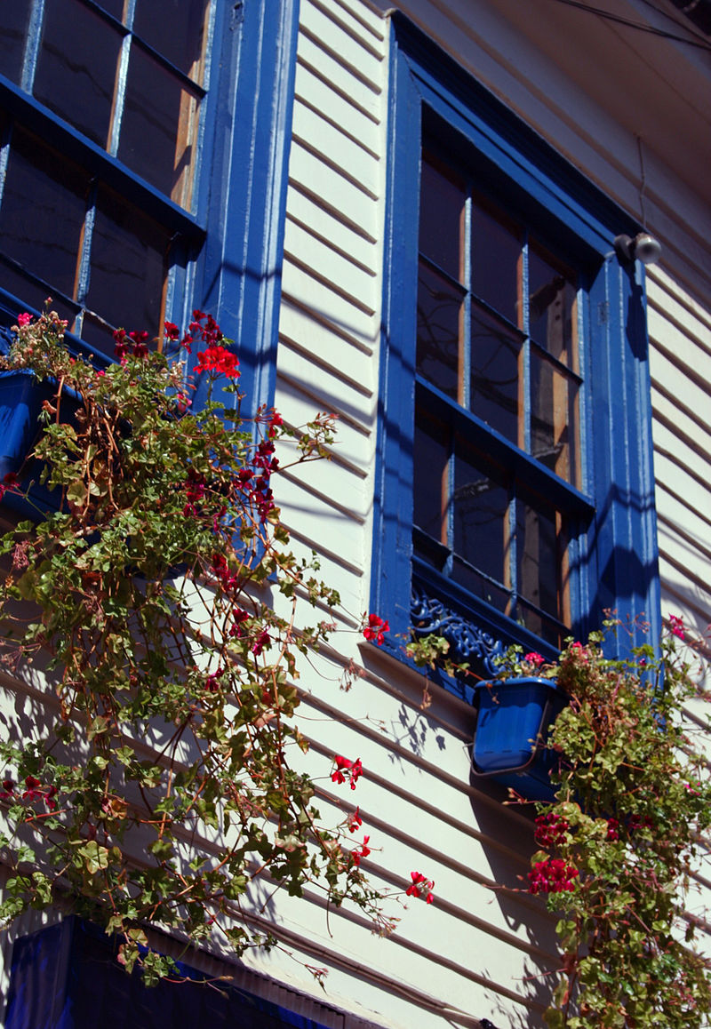
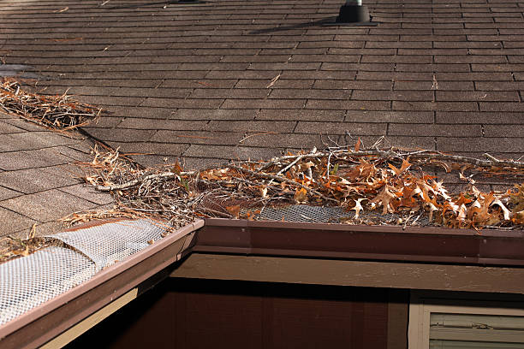
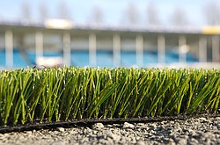
Items likely to be ignited by embers
No items that are likely to be ignited by embers are permitted within Zone 0, including but not limited to combustible boards, timbers, firewood, synthetic lawn, attached window boxes, and trellises. The roof and rain gutters of a Building or Structure shall be kept clear of leaves and needles.

Slide 50
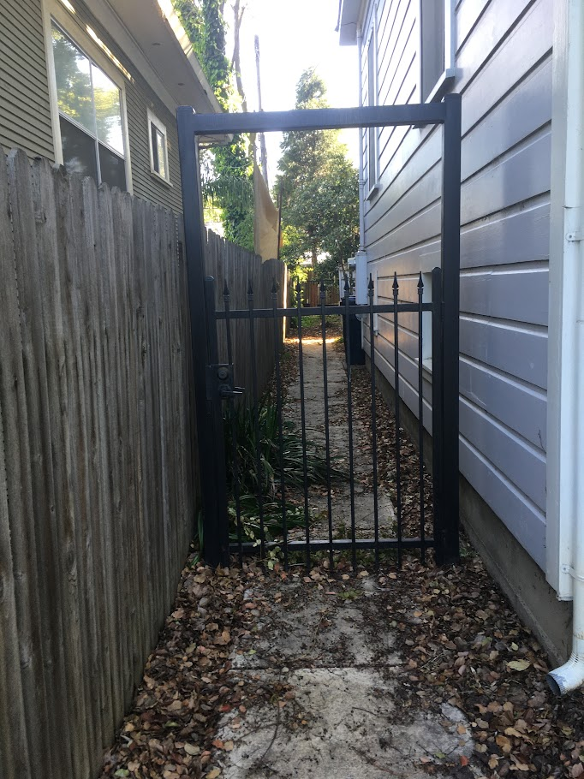
Gates
(4) Combustible gates that are directly attached to a Building or Structure are not permitted in Zone 0.

Slide 51
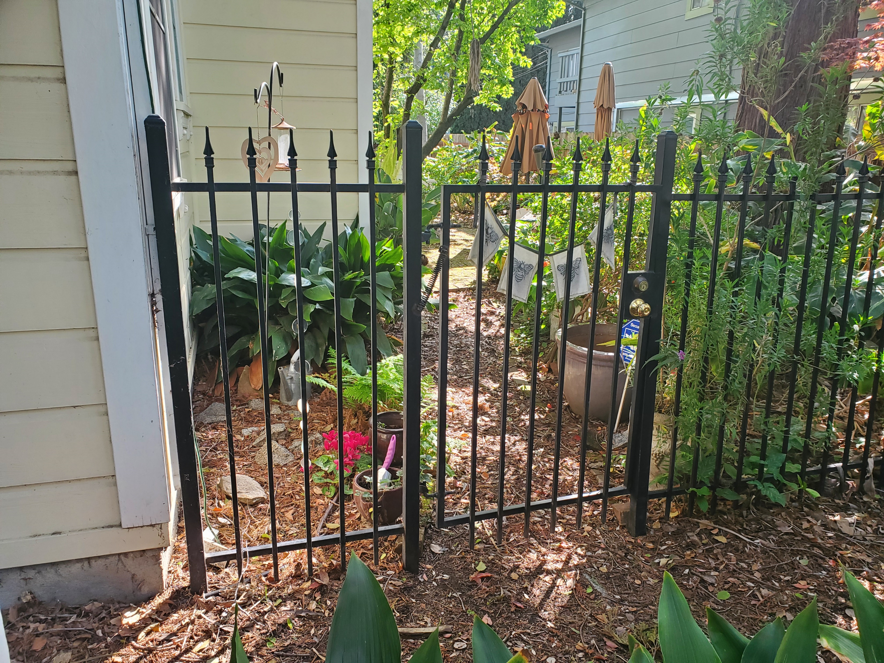
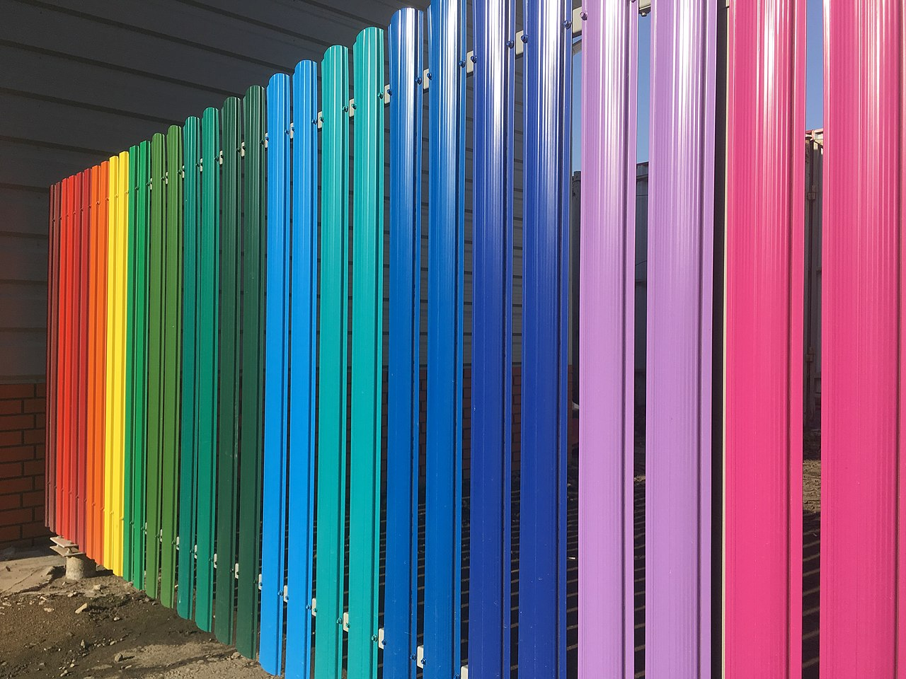
Fences
(5) Fences that are directly attached to a Building or Structure shall have a five foot (5 ft) non-combustible span at the point of attachment. After the effective date of this regulation, no new sections of combustible fence are permitted within 5 feet of a Building or Structure including an attached deck.

Slide 52
Outbuildings
(6) Outbuildings are not permitted in Zone 0, unless constructed according to the standards in Chapter 7A (commencing with Section 701A.1) of Part 2 of Title 24 of the California Code of Regulations. Outbuildings that meet these standards shall be considered part of the Building or Structure for purposes of determining Zones 0, 1, and 2.

Slide 53

Timelines
(7) The requirements for Zone 0 shall take effect for New Buildings or Structures upon the date that the guidance document, as described in PRC § 4291(e), is updated and for existing Buildings or Structures three years thereafter. Upon updating the guidance document, the Board shall post it on its website.

Slide 54
Staging, scope of work
(8) The Department may allow for the staging of work for existing structures and take into account the scope of work necessary to achieve compliance.

Slide 55
1299.03(c) Zone 1: Clarity Changes
(ac) Zone 1 Requirements:
(1) Remove all dead or dying grass, plants, shrubs, trees, branches, leaves, weeds, and pine needles from the Zone whether such vegetation occurs in yard areas around the “Building or Structure,” on the roof or rain gutters of the “Building or Structure,” or any other location within the Zone.

Slide 56
1299.03(c) Zone 1: Clarity Changes
(2) Remove dead tree or shrub branches that overhang roofs, below or adjacent to windows, or which are adjacent to wall surfaces, and keep all branches a minimum of ten feet (10 ft.) away from chimney and stovepipe outlets.
(3) Relocate exposed firewood piles outside of Zone 1 unless they are completely covered in a fire resistant material.
(4) Remove flammable vegetation and items that could catch fire which are adjacent to or under combustible decks, balconies and stairs.

Slide 57
1299.03(c) Zone 1: Transition Zone
Potential requirements for the area five to ten feet from a Building or Structure to limit ignition.
  Maximum shrub/ornamental plant type
  Tree pruning requirements
  Groundcover requirements

Slide 58
Next Steps
May Workshop/Discussion of Rule Plead
Public Comment Period
Public Hearing
Board Responds to Comments
Board Approves Draft Rule Text and ISOR

Slide 59
Highlighted Text Overview
Attached decks
Potted Plants
Gates
Fences
Staging
Additional measures/Transition Zone
Outbuildings in Zones 1 and 2

Slide 60
Highlighted Text Overview
Attached decks
Potted Plants
Gates
Fences
Staging
Additional measures/Transition Zone
Outbuildings in Zones 1 and 2

Slide 61
§ Attached Decks
(b) Building or Structure. Anything constructed that is designed or intended for support, enclosure, shelter, or protection of persons, animals, or property, having a permanent roof that is supported by walls or posts that connect to, or rest on the ground. A structure for the purpose of an ember-resistant zone includes an attached deck.

Slide 62
1299.03(b)(1)(A) Potted Plants
(A) Exception: Plants in pots are allowable if they are in areas that are not directly beneath, above, or adjacent to a window; are kept in an unaffixed, not combustible pot or container that is no larger than 5-gallon capacity; and set apart by 1.5 times the height of the plant or 12 inches, whichever is greater, from the structure and each other. These plants shall be no greater than 18 inches in height. Dead or dying material on the plants shall be removed.

Slide 63
1299.03(b)(4) Gates
(4) Combustible gates that are directly attached to a Building or Structure are not permitted in Zone 0.

Slide 64
1299.03(b)(5) Fences
(5) Fences that are directly attached to a Building or Structure shall have a five foot (5 ft) non-combustible span at the point of attachment. After the effective date of this regulation, no new sections of combustible fence are permitted within 5 feet of a Building or Structure including an attached deck.

Slide 65
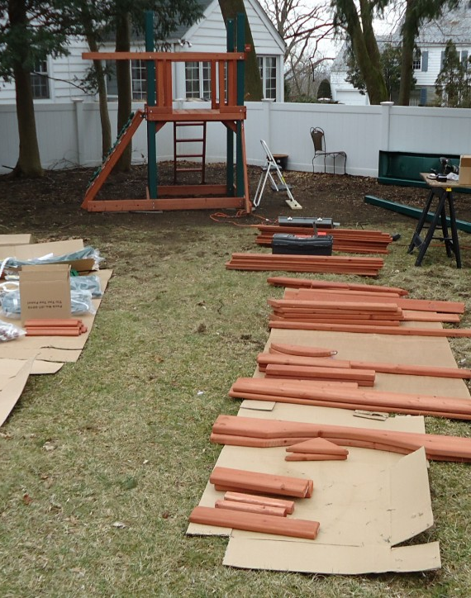
Staging, scope of work
(8) The Department may allow for the staging of work for existing structures and take into account the scope of work necessary to achieve compliance.

Slide 66
Zone 1: Transition Zone
Potential requirements for the area five to ten feet from a Building or Structure to limit ignition.
  Maximum shrub/ornamental plant type
  Tree pruning requirements
  Groundcover requirements

Slide 67
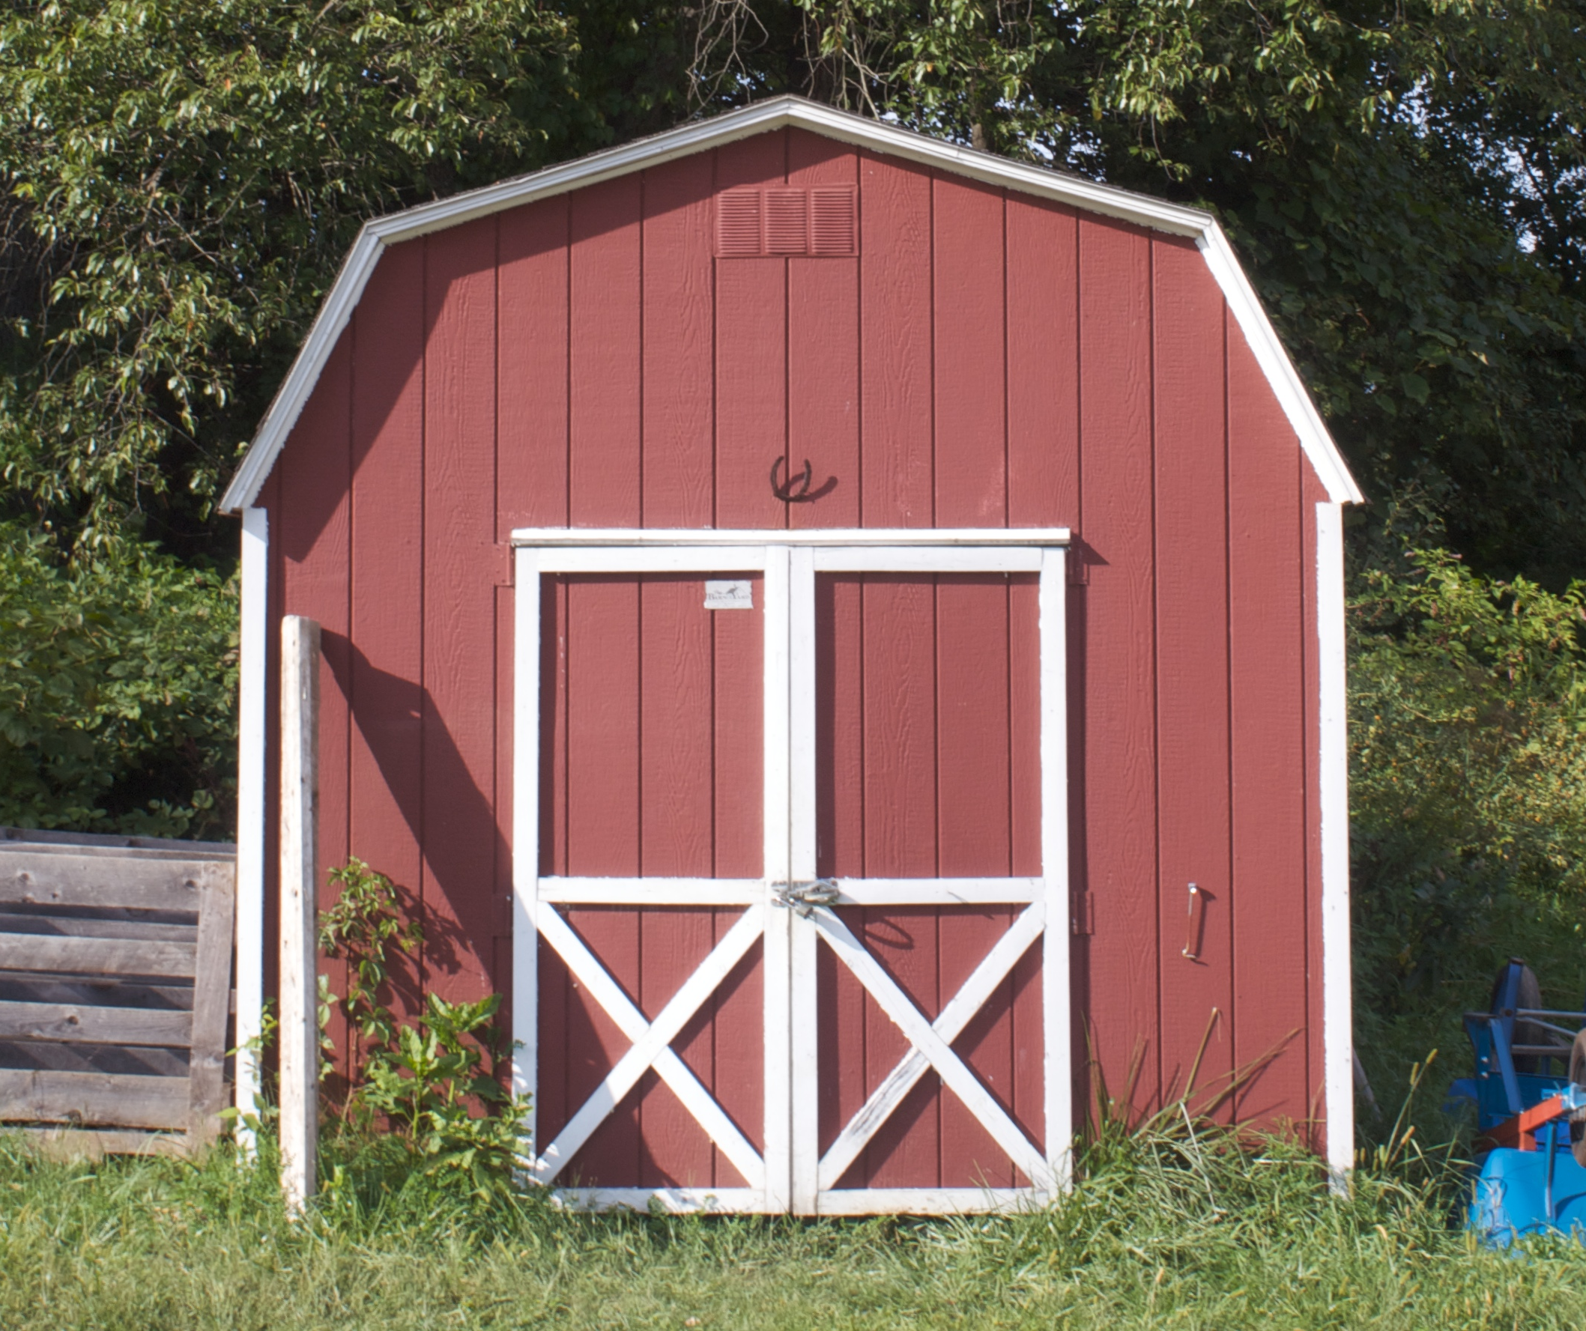
1299.03(e) Outbuildings in Zone 1 and 2
(1) “Outbuildings” and Liquid Propane Gas (LPG) storage tanks shall have the following minimum clearance: ten feet (10 ft.) of clearance to bare mineral soil and no flammable vegetation for an additional ten feet (10 ft.) around their exterior.

Slide 68
General Comments

Slide 69
Potted Plants
(A) Exception: Plants in pots are allowable if they are in areas that are not directly beneath, above, or adjacent to a window; are kept in an unaffixed, not combustible pot or container that is no larger than 5-gallon capacity; and set apart by 1.5 times the height of the plant or 12 inches, whichever is greater, from the structure and each other. These plants shall be no greater than 18 inches in height. Dead or dying material on the plants shall be removed.

